Slide 1


Operational manager and principal
funder of YPI in Scotland

Slide 2
PHILANTHROPY

Slide 3
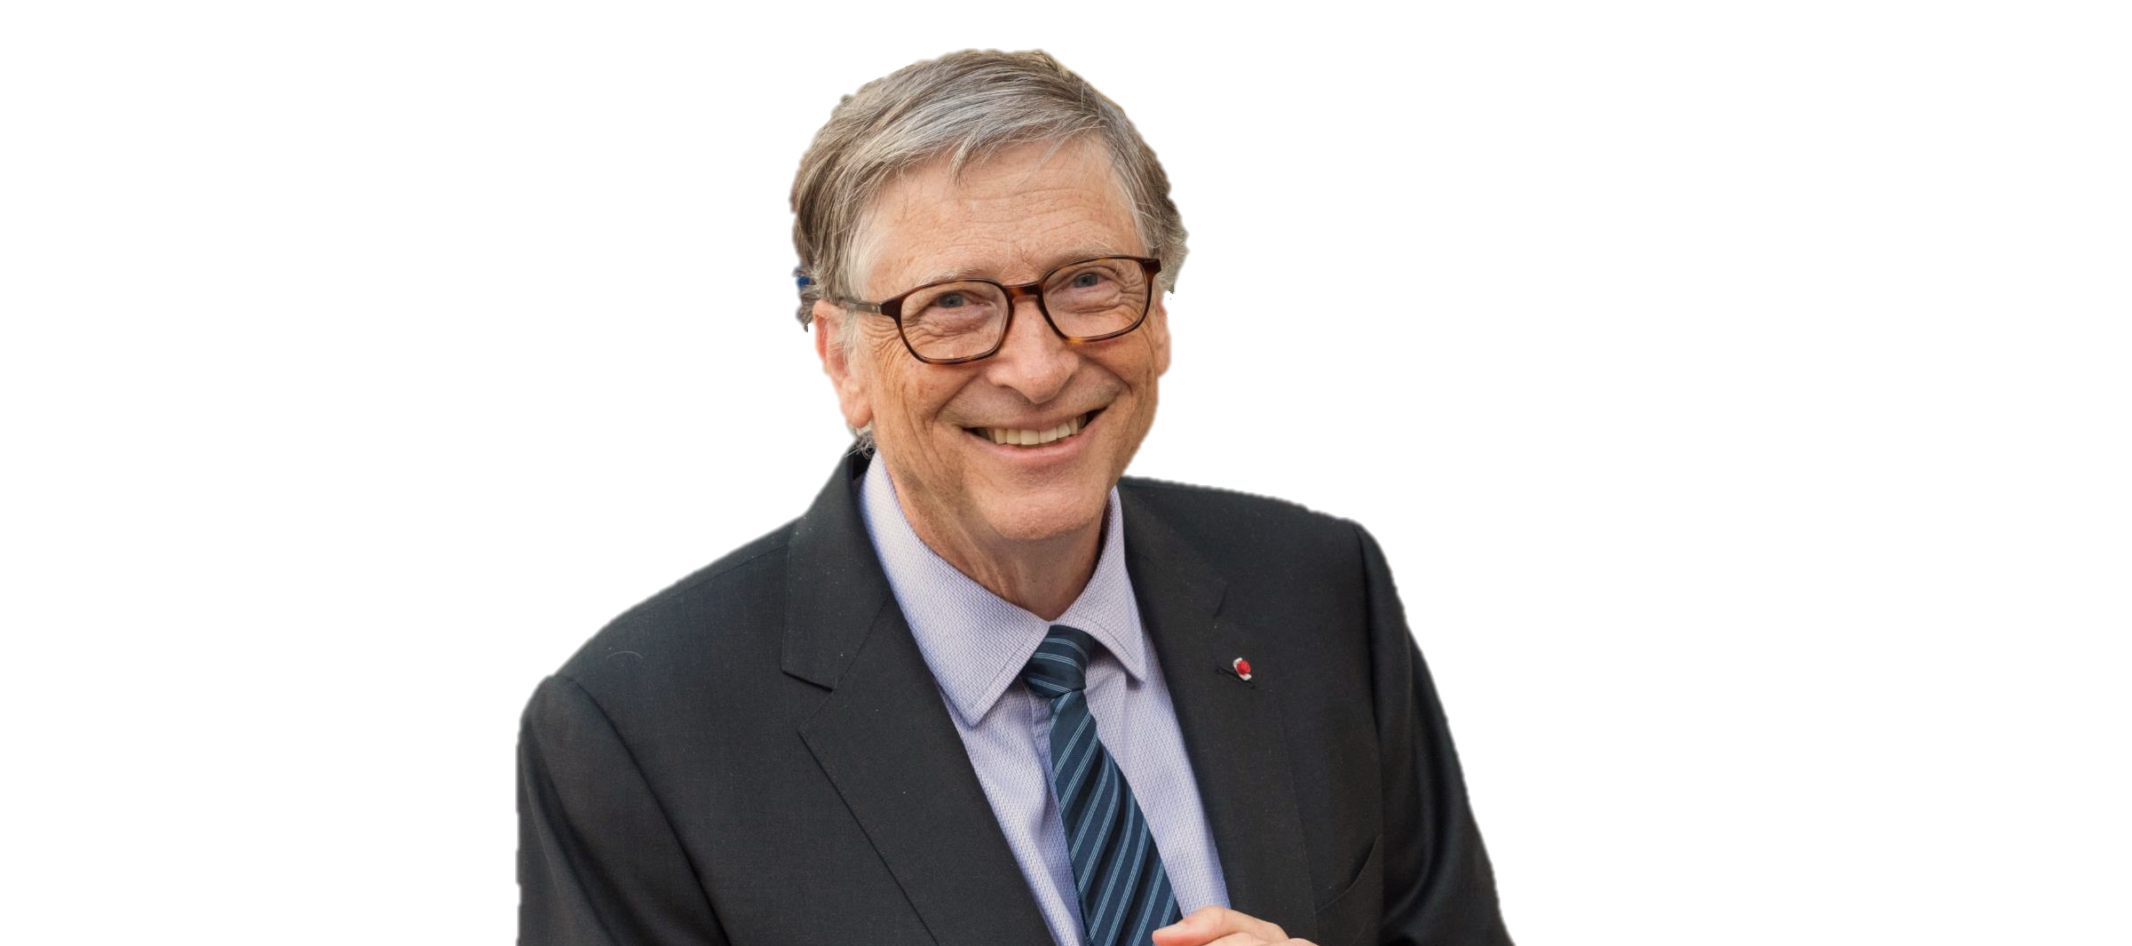
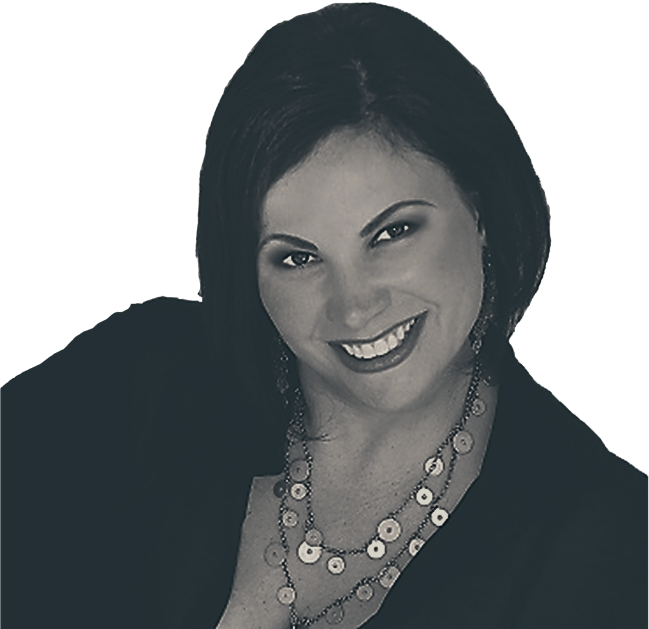

Slide 4

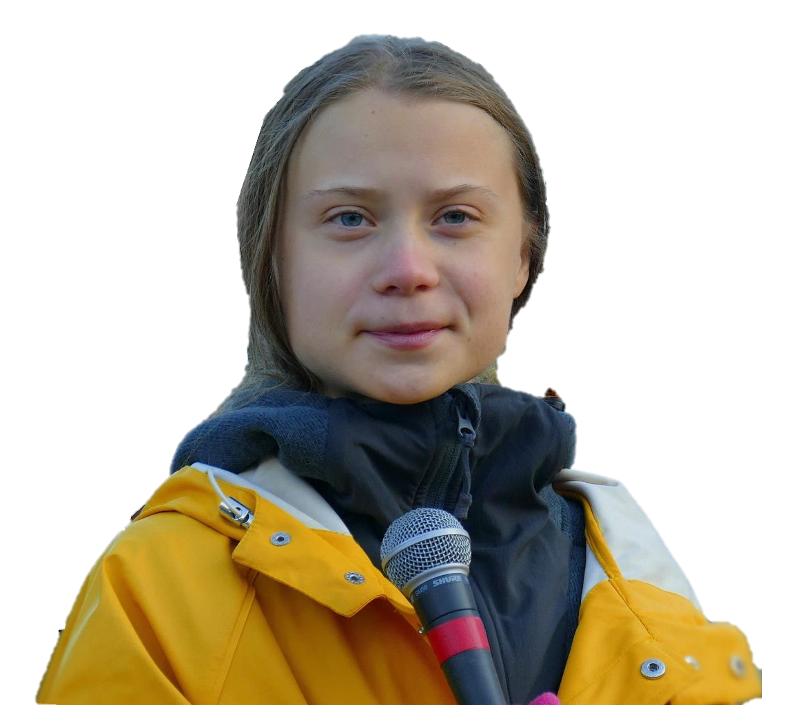

Slide 5
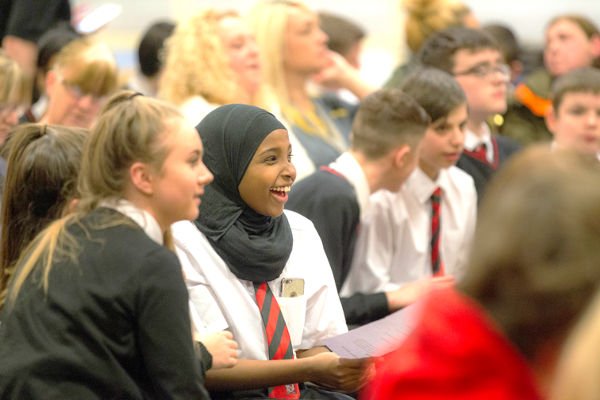

Slide 6
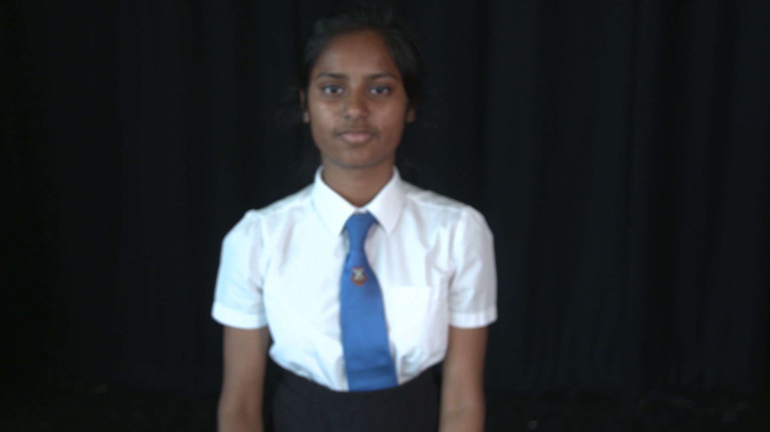

Slide 7
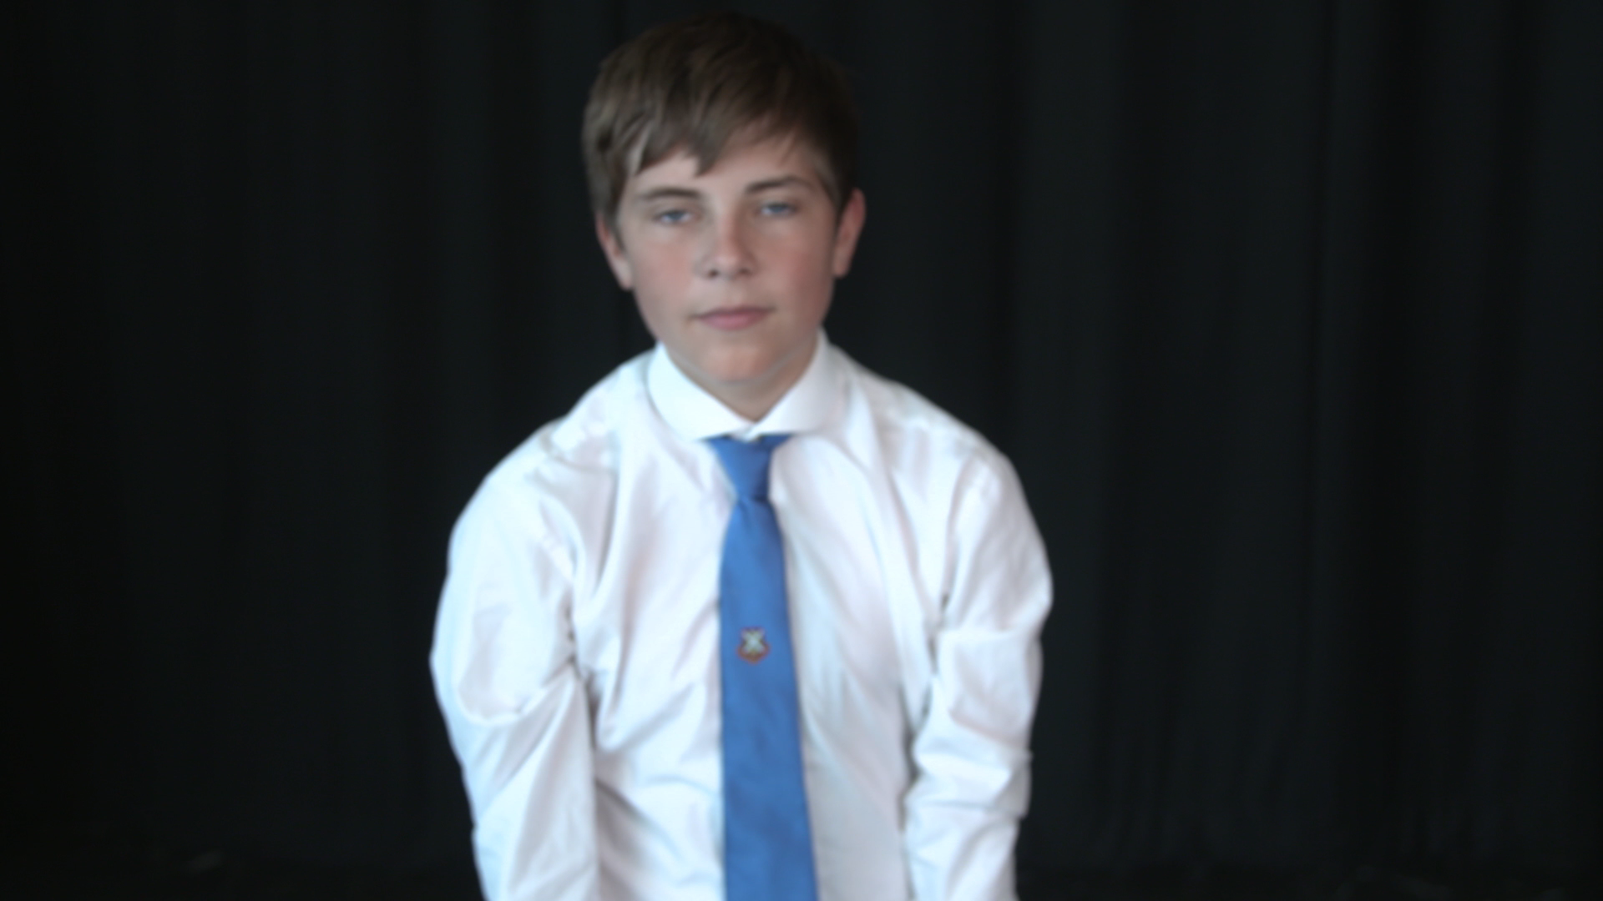

Slide 8
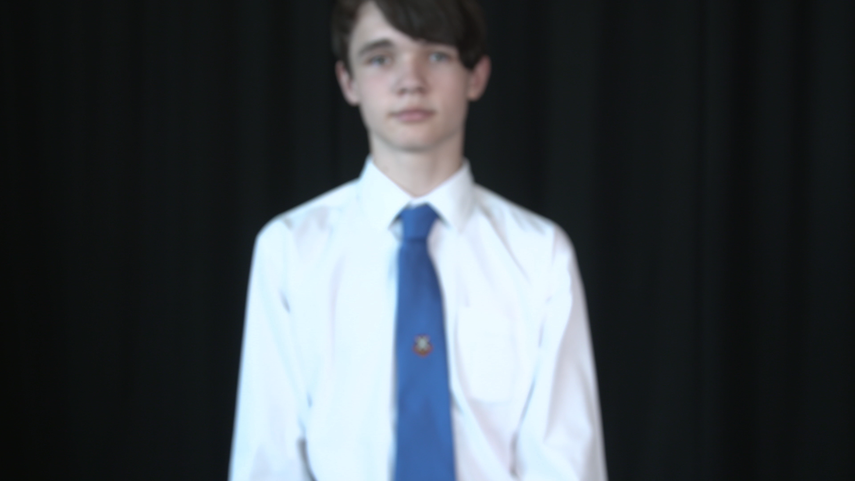

Slide 9
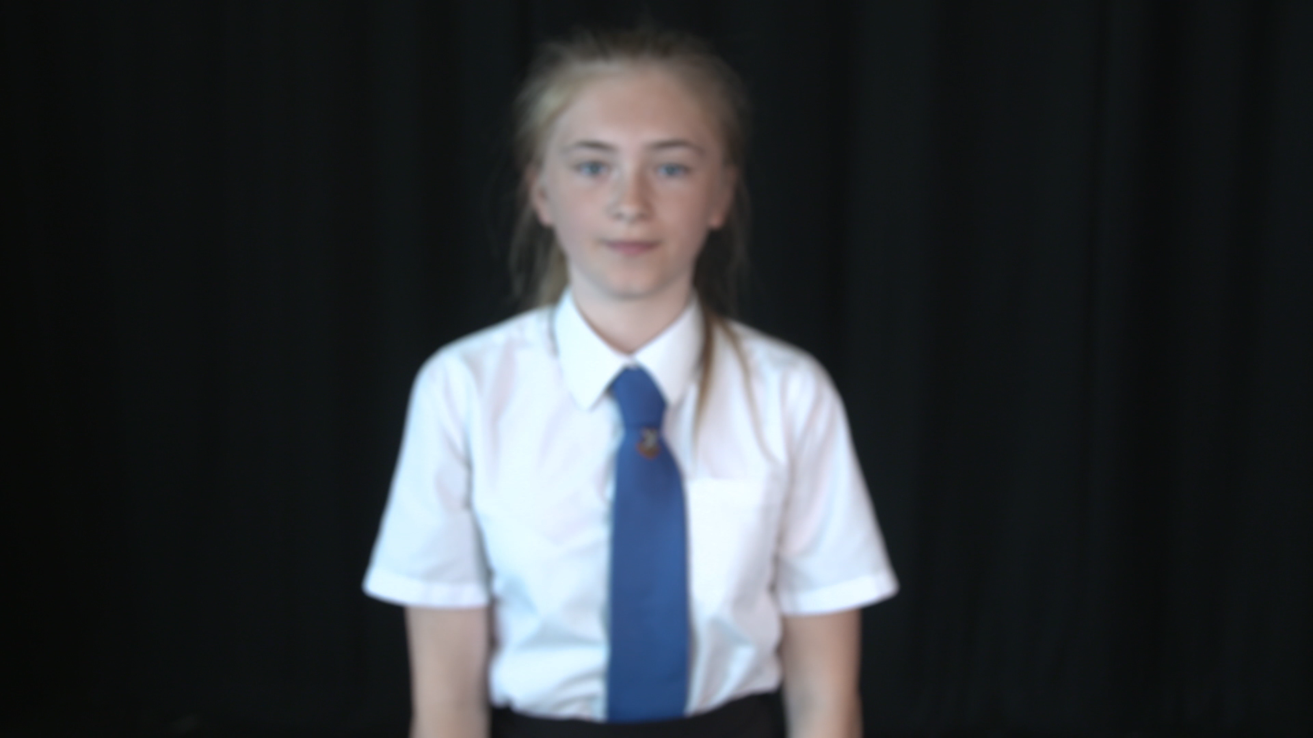

Slide 12


Slide 13
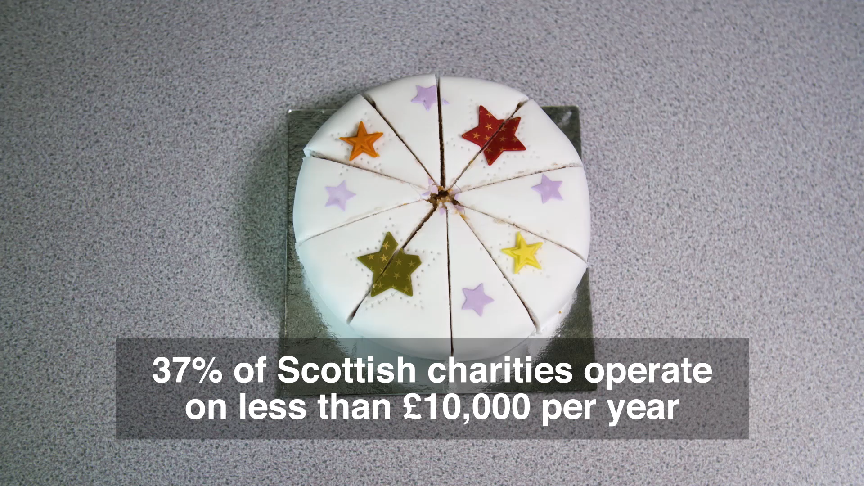

Slide 14
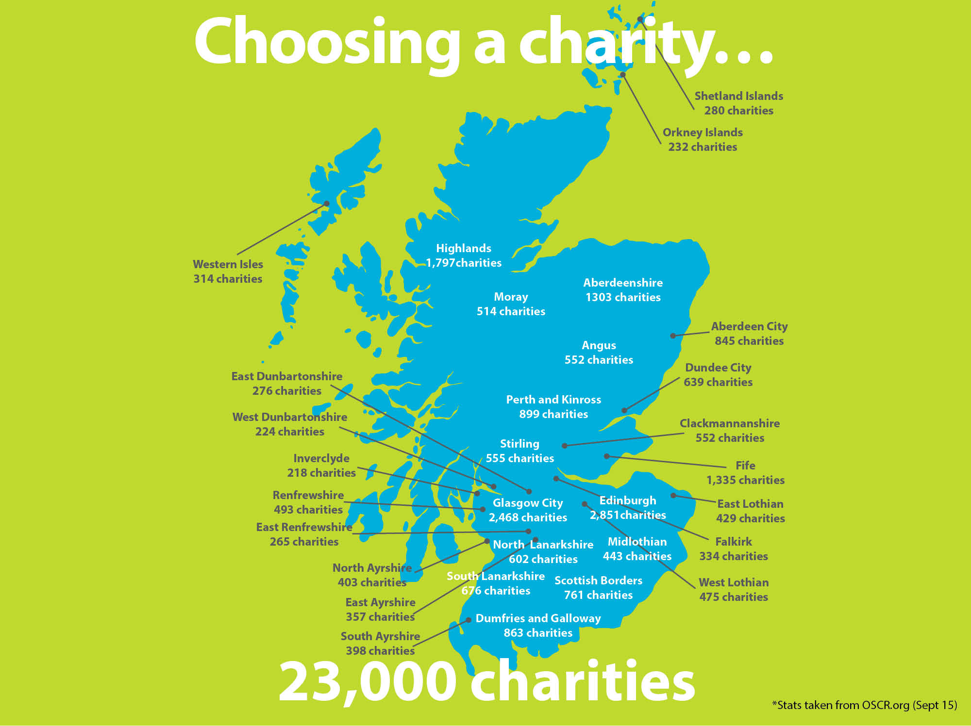

279
250
1,880
349
536
1,348
873
568
261
655
920
233
186
544
217
1,375
517
2,739
2,939
453
269
Argyll and Bute
855 charities
605
443
360
409
718
813
515
362
885
416
25,070
*Stats taken from OSCR.org.uk (Aug 2020)

Slide 15
WWW.OSCR.ORG.UK

Slide 16
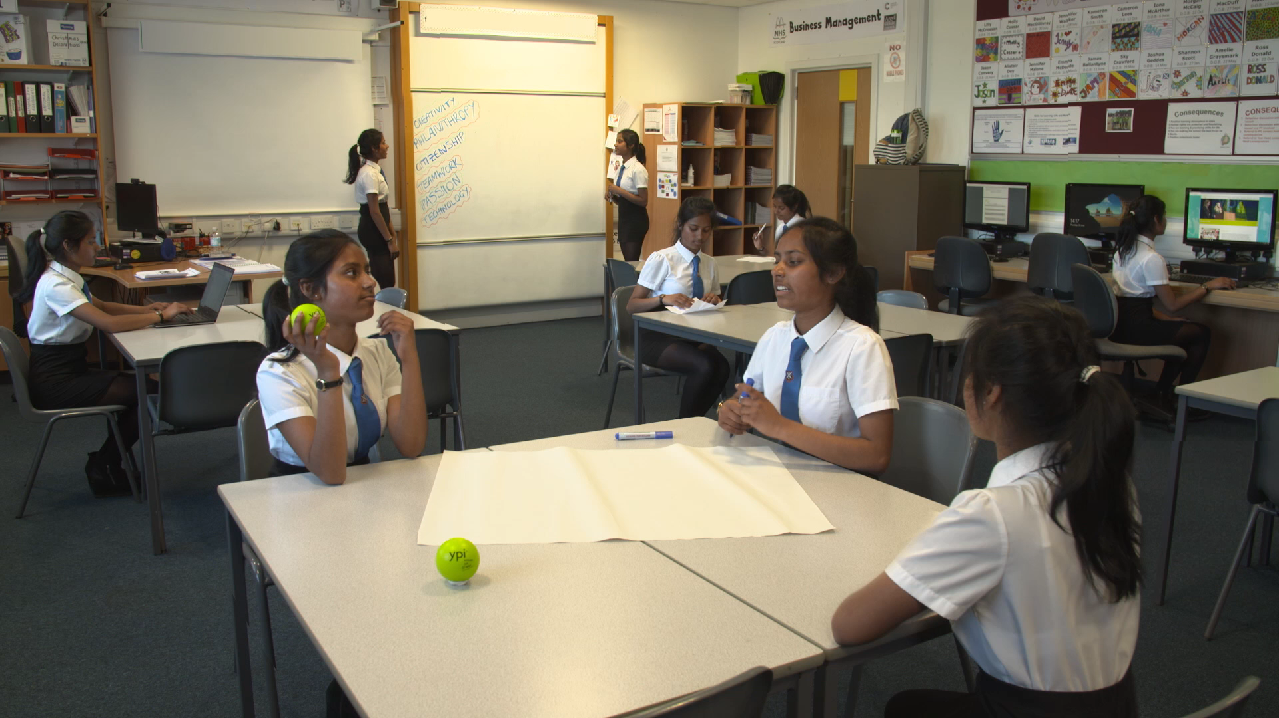

Slide 17
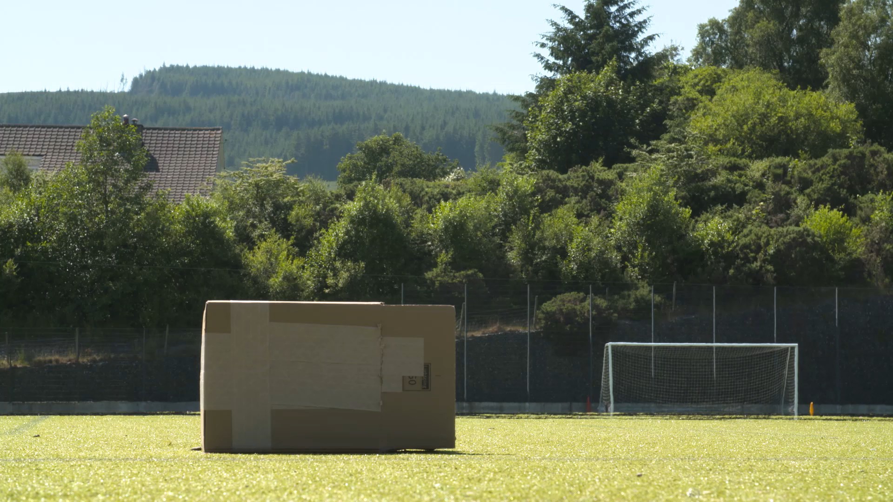

Slide 18
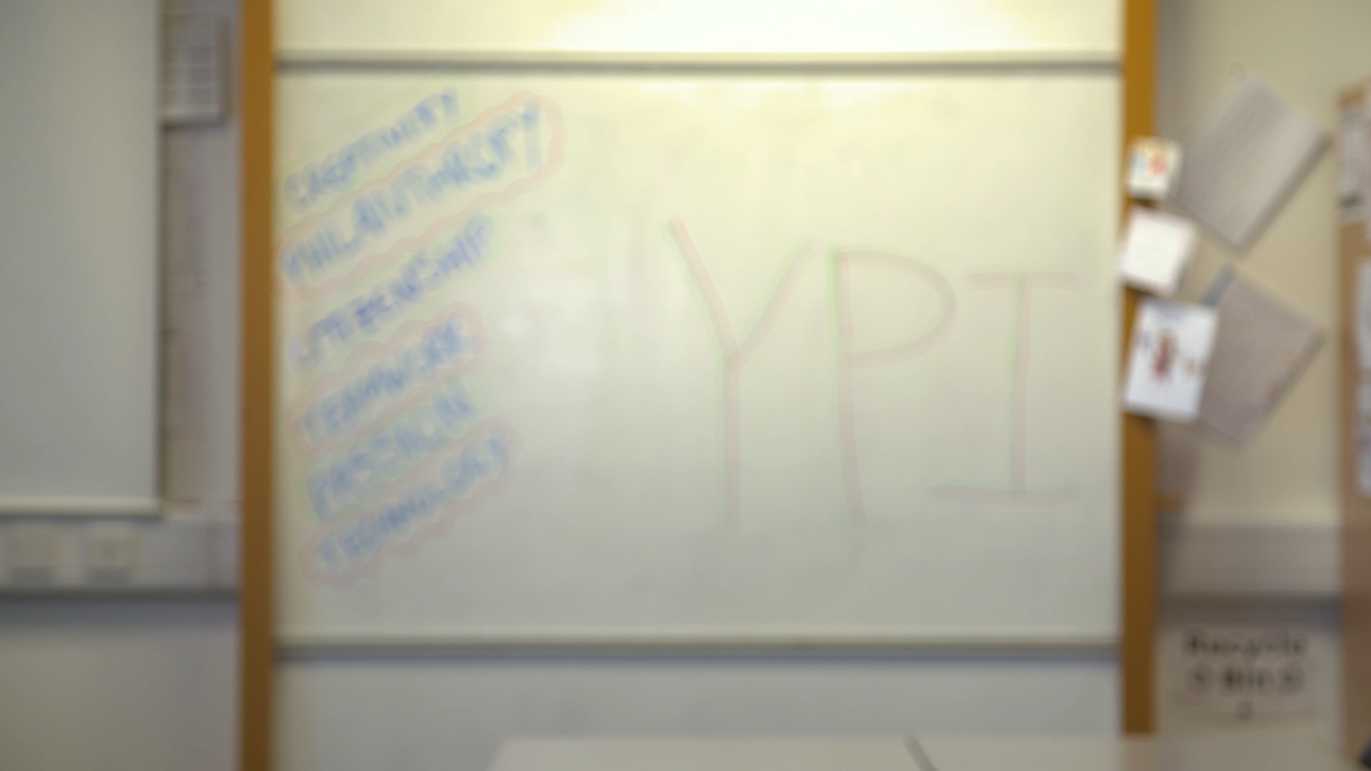

Slide 19

Good Luck!
Instagram: @YPI_Scotland
Twitter: @YPI_Scotland
www.ypiscotland.org.uk
YPI Scotland National Partner

Slide 20
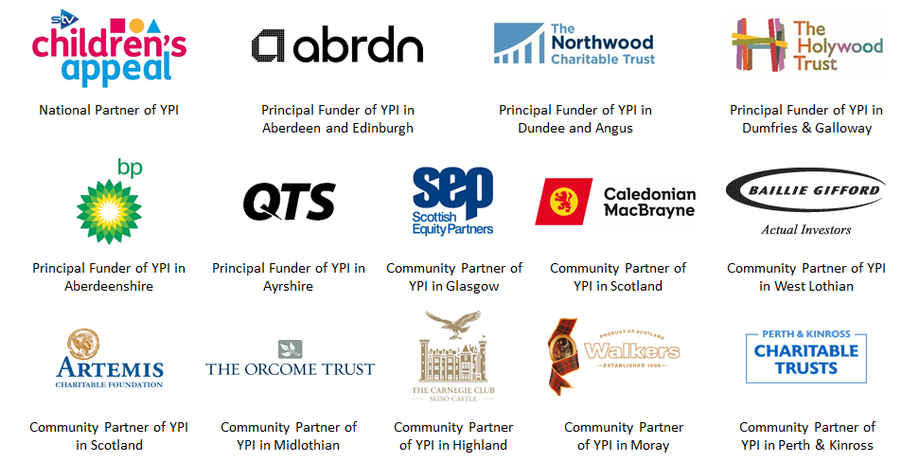
Our Funding Partners

