Slide 1


Slide 2

What is the Youth and Philanthropy Initiative?
The Youth and Philanthropy Initiative (YPI) is a programme which empowers young people to make a difference in their communities whilst developing a range of skills including teamwork, communication and creativity.
Each school is responsible for directing a grant of £3000 to a local charity championed by its students.

Slide 3
What is the Youth Philanthropic Initiative?
The programme raises awareness of social issues in the local area and supports local charities.
Since it was introduced to Scotland in 2008 by The Wood Foundation (TWF), it has involved more than 430,000 people who have taken responsibility for £9.3m of charitable giving.

Slide 4

YPI Launch
https://ypiscotland.org.uk/school-zone/

Slide 5


IS ABOUT
MAKING A DIFFERENCE

Slide 6

What is Philanthropy?
Philanthropy is doing something for the public good to improve other people's lives.
Philanthropy often involves donating money for things that need to be done or can involve giving up your time to help other people.
The word "philanthropy" comes from the Greek word that means "love of humanity".

Slide 7

YPI Funding Partners for 2026/27

Slide 8
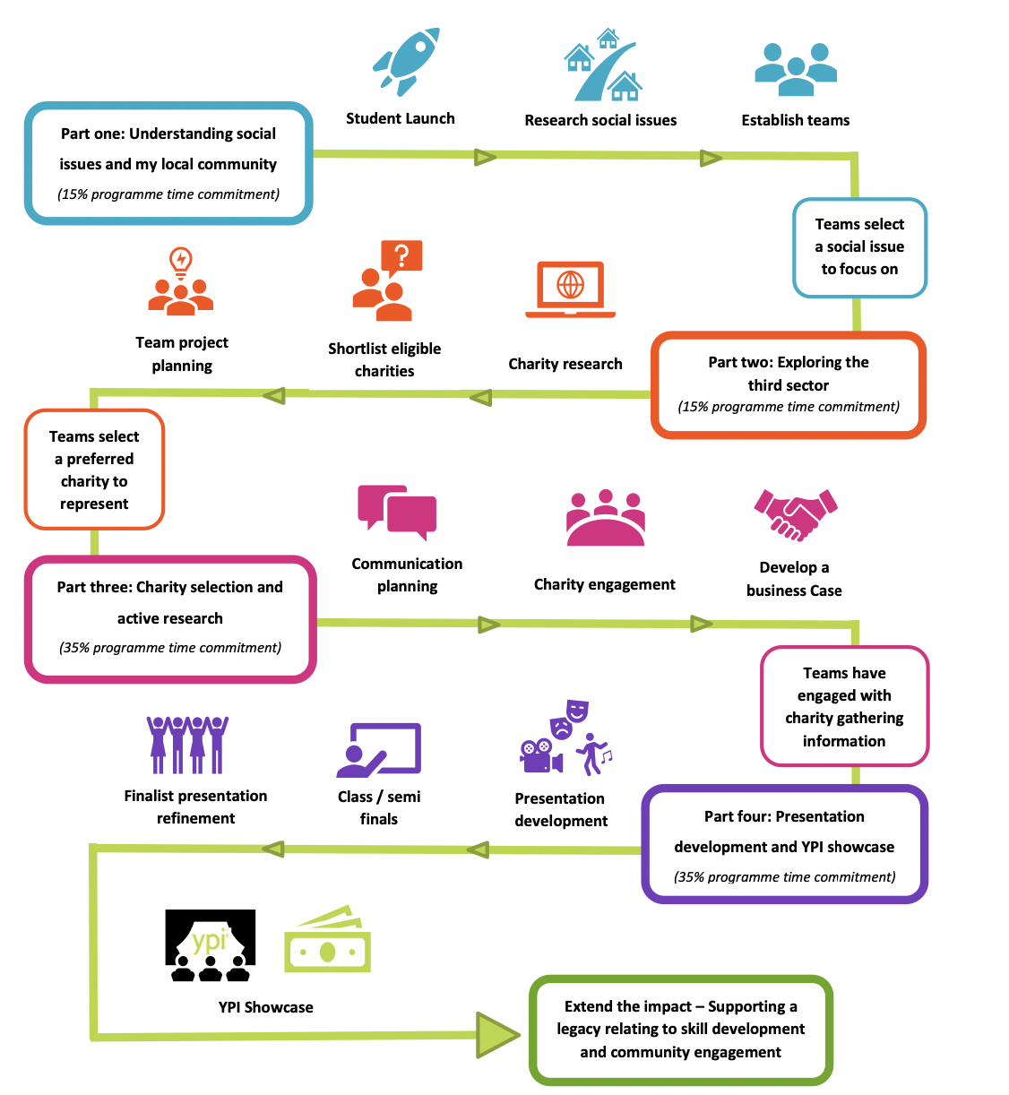
YPI Pathway
What are we going to do over the next 5 days?
What is a social issue?

Slide 9
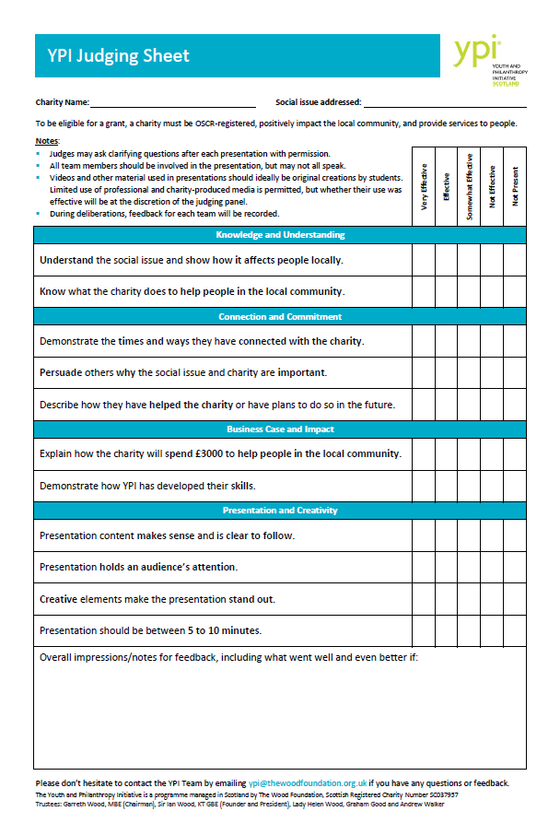

Slide 12
Through YPI you will:
Work in small teams to research the needs of your local community.
Identify a social issue and charity which you feel is important in your community.
Explore the third sector to better understand how charities operate.
Select and build relationships with representatives from a charity that you have selected.
Present on the reasons your proposed charity is most deserving of support.

Slide 13
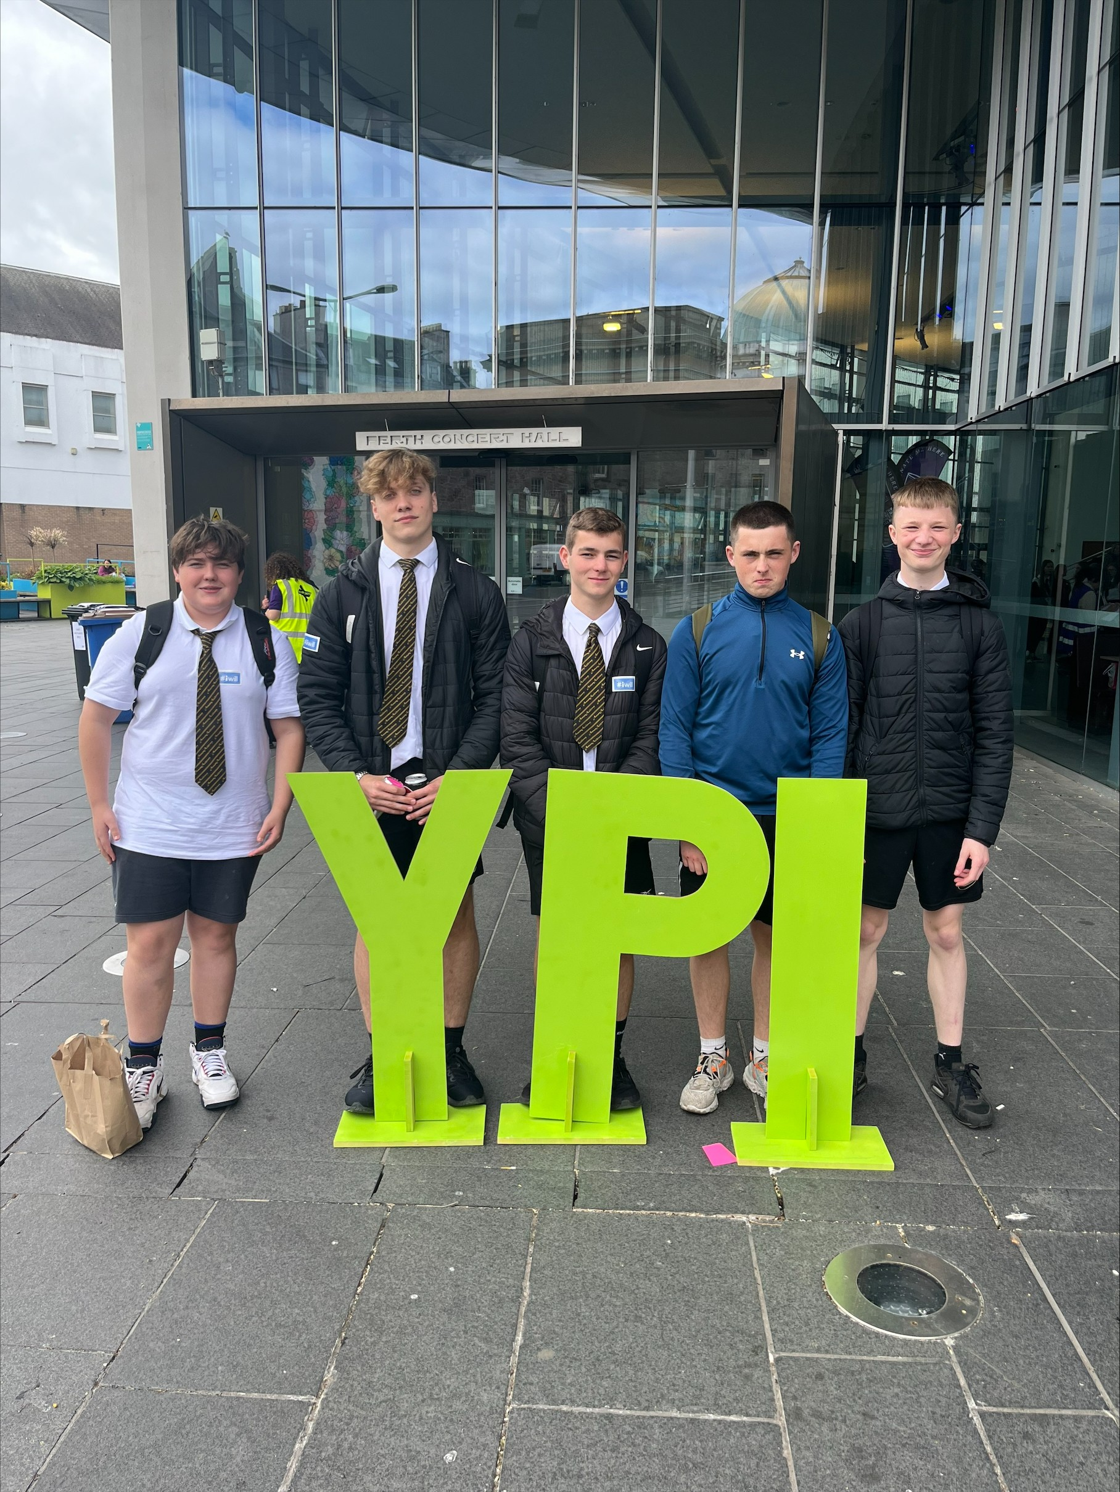
Through YPI you will:
Previous winners Marley, Theo and Keigan will now tell you about their experience of YPI.

Slide 14
Timeline for this week…
Monday
YPI Launch – Group creation – Social Issue/Charity Research
Tuesday
Choose charity and begin to contact them
Wed. – Thu.
Contact/meeting/visit your chosen charity – creation of presentation
Friday
Presentations to be delivered periods 1-4. The best 4/5 presentations will then have to present again at the final showcase periods 5&6.
Assembly hall
Plaza
Plaza
Plaza

Slide 15
Expectations
You must remain on school grounds until 3:30pm. Do not leave before the bell.
Clean up after yourself. Make sure that the Plaza/F45 are as tidy as you found it!
Laptops: these are booked for your use all week. Ensure they are put away properly and plugged in.
Registers will be completed 3x daily (morning/break/after lunch).
Consider your noise level especially if in F45.

Slide 16
Visiting Charities
You can decide to go out and visit your chosen charity. You must make sure to sign out at the office and inform Miss Grierson of your visit.
There must be at least two of you who visits the charity. You cannot go alone.
The school will not cover the travel costs as this goes against the main principles of philanthropy. Be creative with how you contact your charities, you can hold Teams, Skype or Zoom meetings, or call them.

Slide 17
Judging Criteria
Clear understanding and knowledge of the social issue and how it IMPACTS the local community
Knowledge of the charity and how they help the community / evidence of engagement with charity
Passionate about social issue / charity / explain how you were personally impacted by YPI / skills
How the charity will spend £3000 and the IMPACT on the local community
Well-structured presentation / interactive element / speak with clarity and enthusiasm and make eye contact

Slide 18

Support
If you need any support during the week please feel free to come and see me in my classroom. I will check in with you all every morning with a briefing.
Teachers will be in and out during the week to see how you are all getting on and they can also try to help with any questions you might have.
Use the YPI website, there are lots of helpful documents on there.
Notes:
https://ypiscotland.org.uk/

Slide 19

Any questions so far?

Slide 20
Part one:
Understanding social issues and my local community
Learning intentions:
To revisit the purpose of engaging in the YPI process.
To understand what a social issue is.
To understand the importance of teamwork for YPI.
To select a social issue as a team to focus on for YPI.

Slide 21
Skills
Manage change
Work with others
Make change
Focusing
Feeling
Curiosity
Concentrating
Engaging
Sorting
Filtering
Social conscience
Empathy
Respect
Sense of responsibility
Observing
Questioning
Researching
Recognising problems

Slide 22
Think, Pair, Share
What is a social issue?
Can you give a definition?
An example?
What is a social issue?

Slide 23
Social issues
When people in your community face barriers to having everything they need for a healthy and independent life financially, emotionally, physically, socially, and mentally.

Slide 24
Class
Discussion
What social issues impact our community?

Slide 25




Class Discussion

Slide 26
Some examples of social issues: can you add 3 more?
Elderly Care | Mental Health | Domestic Abuse
Homelessness | Disability | Bullying
Notes:
Substance misuse, young carers, Food poverty

Slide 27
Task 1
Example of social issues: Rank the social issues from most important to least important.
Elderly Care | Mental Health | Domestic Abuse
Homelessness | Disability | Bullying
Substance Misuse | Food Poverty | Gender Inequality
Activity 1: Diamond 9
Most important
Least important

Slide 28
Class
Discussion
What social issue did you put as the most important?

Slide 29
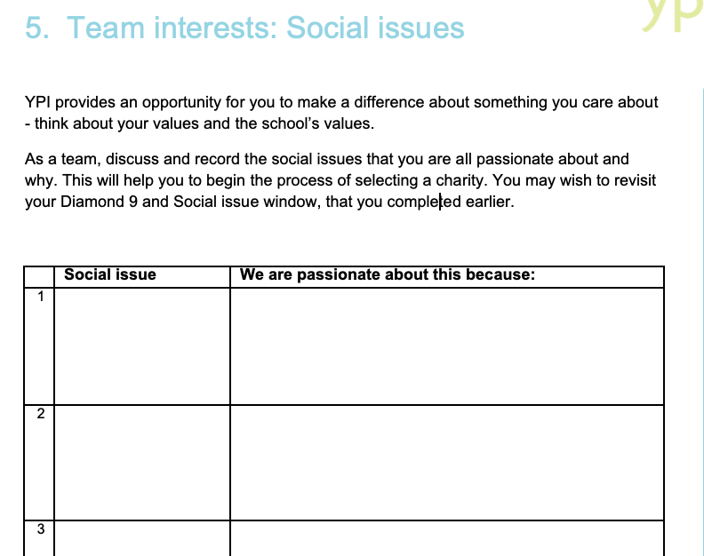
Task 2 – In groups, decide which social issue you want to focus on.
Booklet page 4

Slide 30
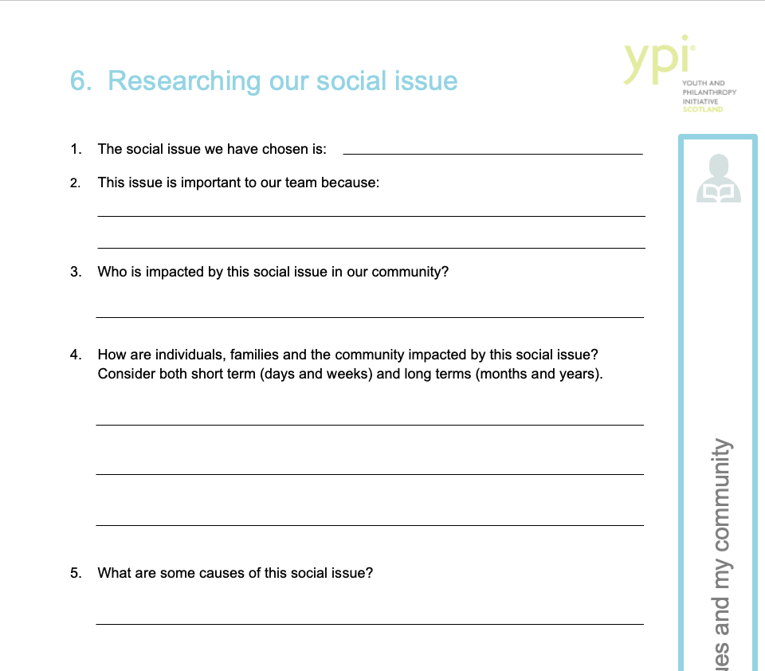
Task 3 – Now you should begin to research your social issue as a group
Booklet pages 5-6

Slide 31
IS ABOUT
COMMUNITY

Slide 32
Part two:
Exploring the third sector
Learning intentions:
To better understand how the third sector and charities operate.
To reflect on how charities evaluate outcomes and impact.
To fully understand the YPI eligibility criteria and shortlist three charities.
To research the impact of shortlisted charities on the local community.
To prepare a team project timeline.

Slide 33
Skills
Manage change
Work with others
Make change
Adapting
Communicating
Sense making
Positive attitude
Reflecting
Being resilient
Persevering
Listening and reading
Talking and writing
Working with technology
Giving information
Receiving information
Analysing
Understanding
Recognising opportunities
Recognising patterns

Slide 34

Activity
To be eligible for the YPI grant your charity must be OSCR registered.
Search the OSCR website
Select two charities registered in your local area.
Find out what they do and who they help.

Slide 35
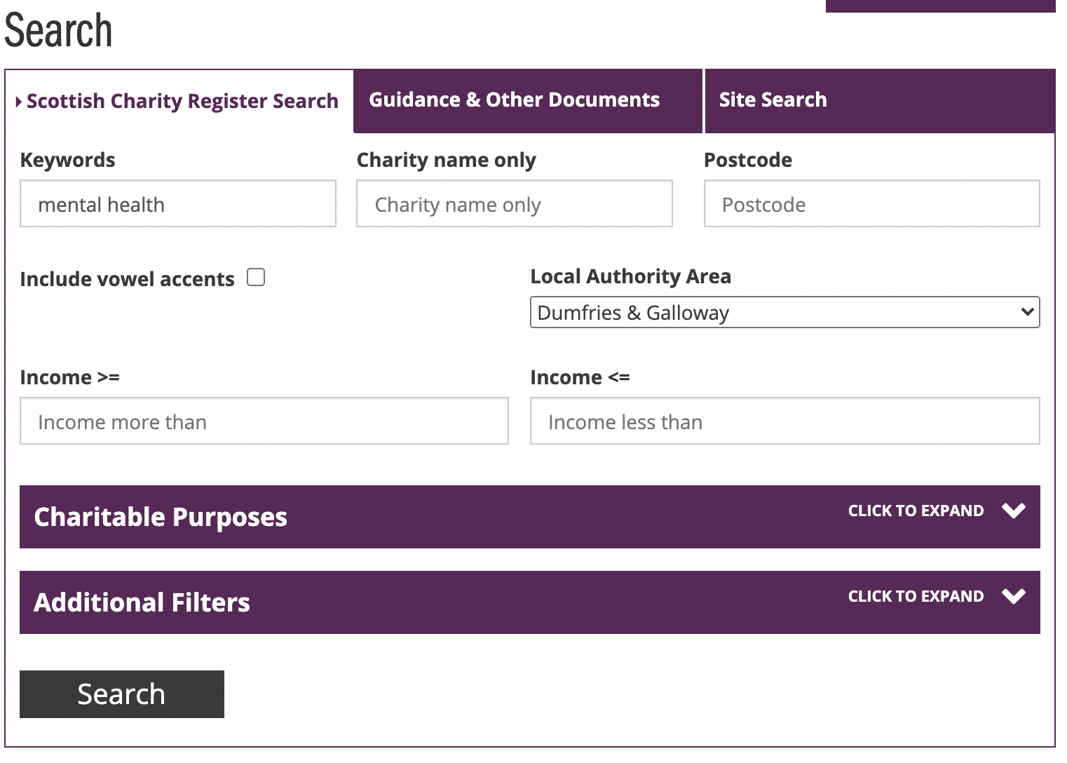


Task 4 – Researching Charities
Search OSCR in a search engine and it should be the first website to appear.
Click on it and this will appear.
Type your chosen social issue into the keywords box.
Select Dumfries and Galloway Local Authority area.
Click search.

Slide 36
Class
Discussion
What charities are working in our local community?
What have you found inspiring?

Slide 37
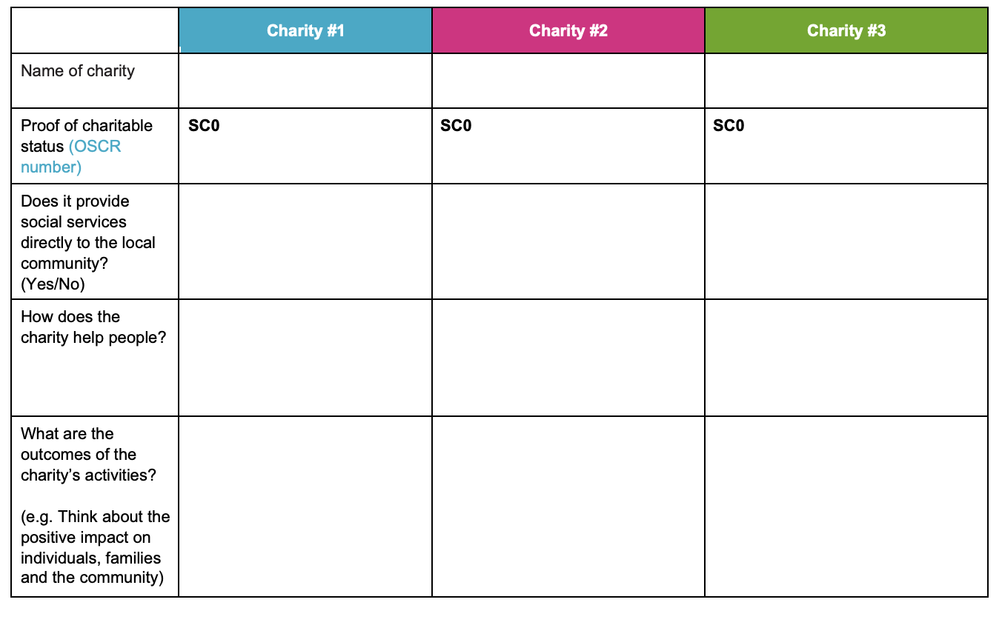
Task 5
You must choose three charities that help tackle your social issue.
You should find out the listed information for each charity and then decide which charity you are going to represent.
Booklet pages 9-10

Slide 38
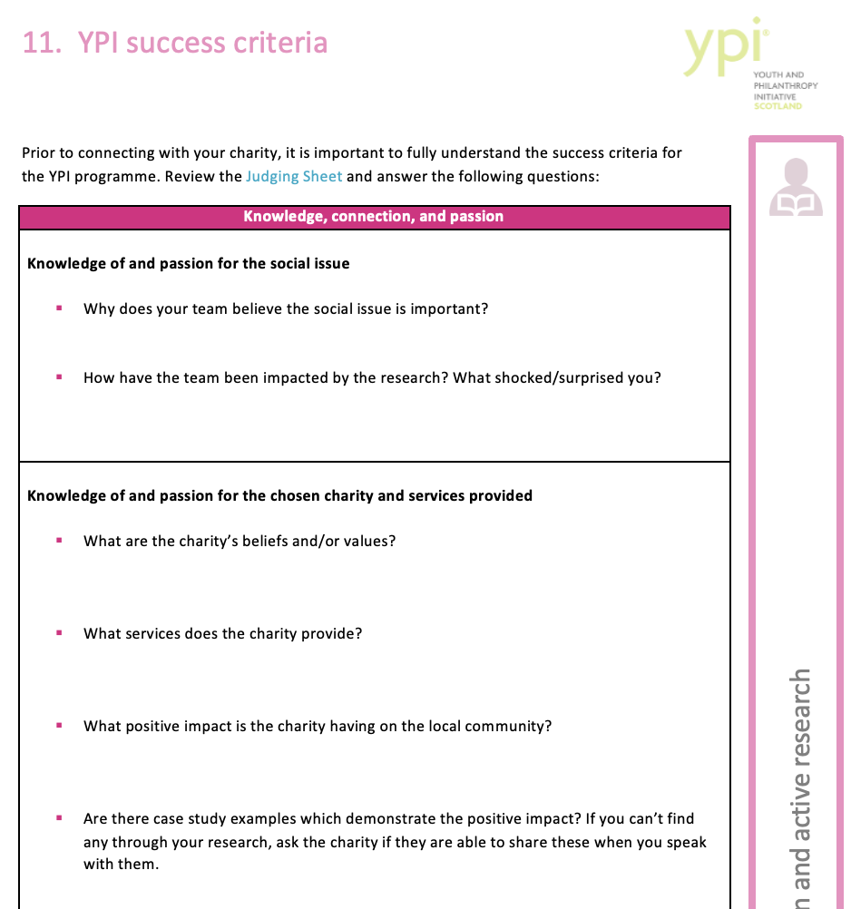
Task 6 – Research your charity
Once you have chosen the charity you would like to represent, you must now become an expert on who they are and what they do.
Complete page 16 in the booklet.
You must find out all the listed information. Use their website to help you!
Any information you cannot find should be written down as a question to ask the charity.

Slide 39
Tasks for Monday
Get into groups of 3-5 include everyone - do not leave people out
Start research on social issues in our local area
Decide on a social issue that you would like to focus on
Research possible local charities (D&G local - doesn’t need to be Annan/Gretna)
Come up with 3 possible charities for consideration by your group.
By the end of today, you should have completed booklet pages 1-10

Slide 40
IS ABOUT
TEAMWORK

Slide 41
Part three:
Charity selection and active research
Learning intentions:
To better understand how the third sector and charities operate.
To reflect on how charities evaluate outcomes and impact.
To fully understand the YPI eligibility criteria and shortlist three charities.
To research and further understand the impact of shortlisted charities on the local community.
To reach a consensus on which charity will be focused on for YPI and prepare a team project timeline.

Slide 42
Skills
Manage change
Work with others
Make change
Initiative
Collaborating
Critical thinking
Building relationships Teamwork
Compromising
Cooperating
Logical thinking
Using judgement
Evaluating
Problem solving
Being resourceful
Self-motivation
Taking responsibility
Decision making

Slide 43
Step 1
Making contact with your charity
Gather the contact details for your charity
  Contact name and job title (position)
  Phone number
  Email address
  Social media account (if the above is not available)

Slide 44
Step 2
Making contact with your charity
Before phoning your charity you should prepare a script that:
Tells the charity your first name, what year you are in and the school you attend.
Explain what YPI is, why you have chosen their charity and how they will benefit from the programme.
Asks the charity if they want to be represented and when would be a good time to arrange a visit or call to interview them.
Booklet page 18-21

Slide 45
Step 3
Making contact with your charity
Before calling:
  Practice your script.
  Make sure you have a pen and something to write on.
If they answer: Use your script. Be polite and interested. Write down what you agree.
If they don’t answer: Leave a very clear voicemail and try again in the future.

Slide 46
Class
Discussion
What information do you need to find out during your charity interview and/or visit?

Slide 47
What information do you need to find out?
How does the charity help people in the local community?
What services do they provide?
If they won the £3000, how would the money be spent? This needs to be a detailed breakdown.
Any other information you could not find online.

Slide 48
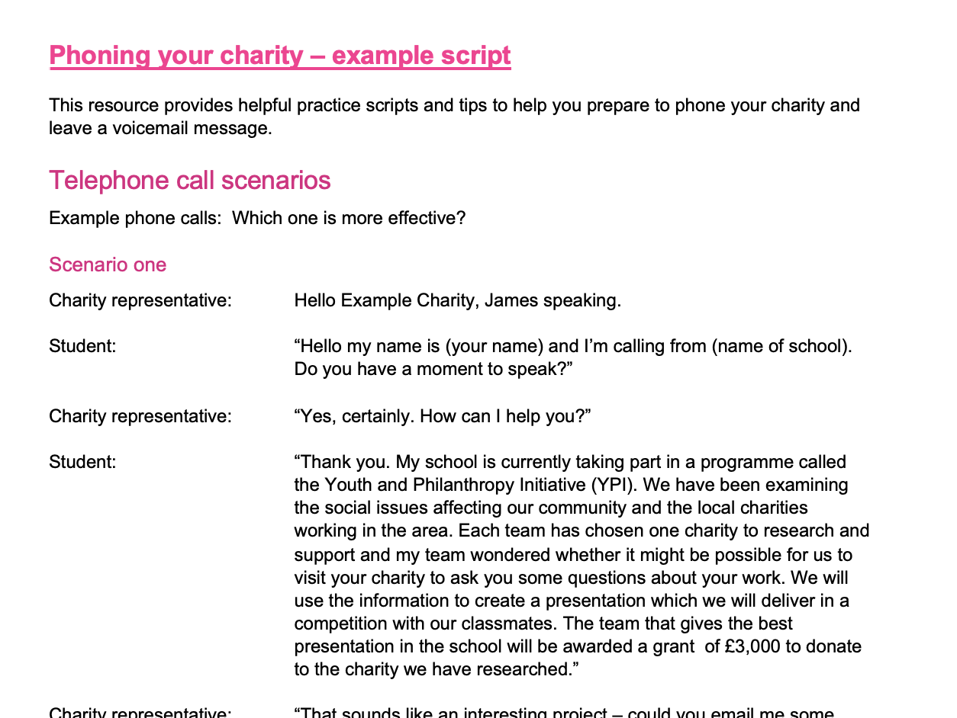
This document can be found on the Teams page.

Slide 49
Tasks for Tuesday
Decide which charity you are going to focus on/back-up
Research the charity online and complete questions in booklet
Prepare a list of questions to ask your charity
Prepare a script to contact the charity and rehearse it
Contact charity to arrange a meeting or visit
Miss and Mrs are going to talk to you all now to show you what a good presentation looks like.

Slide 50
ENCOURAGES YOU TO BE UNIQUE, ENGAGING, THOUGHT-PROVOKING, AND MEMORABLE

Slide 51
Part four:
Presentation development
Learning intentions
To deliver a presentation that demonstrates a clear understanding of the chosen social issue and respective charity, including information relating to impact and outcomes.
To develop and deliver an engaging and creative presentation that fulfils the judging criteria.
To ensure all team members are actively involved in the presentation development process.

Slide 52
Skills
Manage change
Work with others
Make change
Initiative
Collaborating
Creativity
Building relationships Teamwork
Compromising
Cooperating
Imagination
Generating ideas
Designing and innovating
Being resourceful
Being resourceful
Self-motivation
Taking responsibility
Decision making

Slide 53



Class discussion
Look at the following examples of creative presentations. What makes them stand out?

Slide 54
Team discussion
How can you use your talents to make an impactful and memorable presentation?

Slide 55

Presentation Success Criteria
Your presentation needs to have an interactive element. This could be:
  A song/rap/poem
  A dance
  A news report theme
  A quiz
  Anything at all you can think of that links in with the charity!
Your presentation must be at least 6 minutes in length
You are marked on your presentation skills and so you must be passionate, clear, creative, confident and involved!
Booklet page 24

Slide 56
Presentation Success Criteria
Slide 1: Title page of your charity
Slide 2: Explain what your social issue is, any statistics?
Slide 3: Background info on your charity, what do they do? Aims? History?
Slide 4: How does your charity tackle the social issue you chose? How does this social issue impact people in your community?
Slide 5: What has the charity done to help people? Any success stories from the charity? Case Studies?
Slide 6: What will the charity spend the £3,000 on if they won? This needs to be a detailed breakdown of the costs.
Slide 7: How have you been impacted by this project? What have you learned?

Slide 57
When presenting
Everyone must contribute during delivery of the presentation.
You can use cue cards!

Slide 58
Tasks for Wednesday/Thursday
Contact charity again if you have not heard anything
Begin to prepare your presentation
Organise who will say what in the presentation
Rehearse presentation
Sign up to a time slot for your presentation on Friday
is going to talk to you all now to give you some tips on public speaking and presenting.

Slide 59
WHAT NEXT?

Slide 60
Tasks for Friday
Get organised / upload your presentation
Presentations begin at 9:30am. Check your slot
Keep practising even if you have presented
Final showcase begins at 2pm. Finalists be ready at 1:45pm

Slide 61
Class discussion
What did you learn about your values through YPI?
What skills have you developed?
What did you learn about social issues?
Will you continue to help the charity you chose?
What was your greatest learning from your experience with YPI?

