Slide 1


Conquering Creativity

Slide 2
Conquering Creativity
One element of your presentation that judges will be looking for is Creativity. How you incorporate this is in your hands. Can you present all of your pitch in the form of a play? Or will a video or piece of art bring your pitch to life at a specific point of your presentation? It’s up to you to decide the best way to persuade the judges and engage your audience.
The following slides are just suggestions to get you thinking. There may be a creative idea that doesn’t neatly fit into any of the categories presented, and that’s okay.
Bring your talents - or develop new ones - and find your own way to conquer creativity.

Slide 3






Arts and Crafts
Posters
Leaflets
Models
Baking
Display boards
Accessories

Slide 4






Activities with Audiences
Movement
Quiz
Hands up
Challenges
Live demonstrations
Games

Slide 5




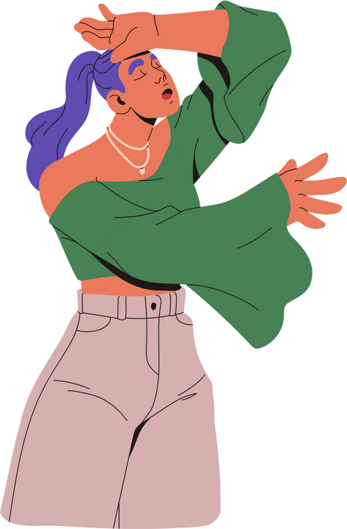

Bring the Drama
Dance
Poems
Story Telling
Costumes
Acting
Puppetry

Slide 6






Show and Tell
Example kit
Food Parcels
Demonstrations
Care packages
Live interviews
Service animals

Slide 7






Digital Skills
Digital art
Website design/Coding
Digital comic book
Animations/Graphics
Game design
Digital Photography

Slide 8
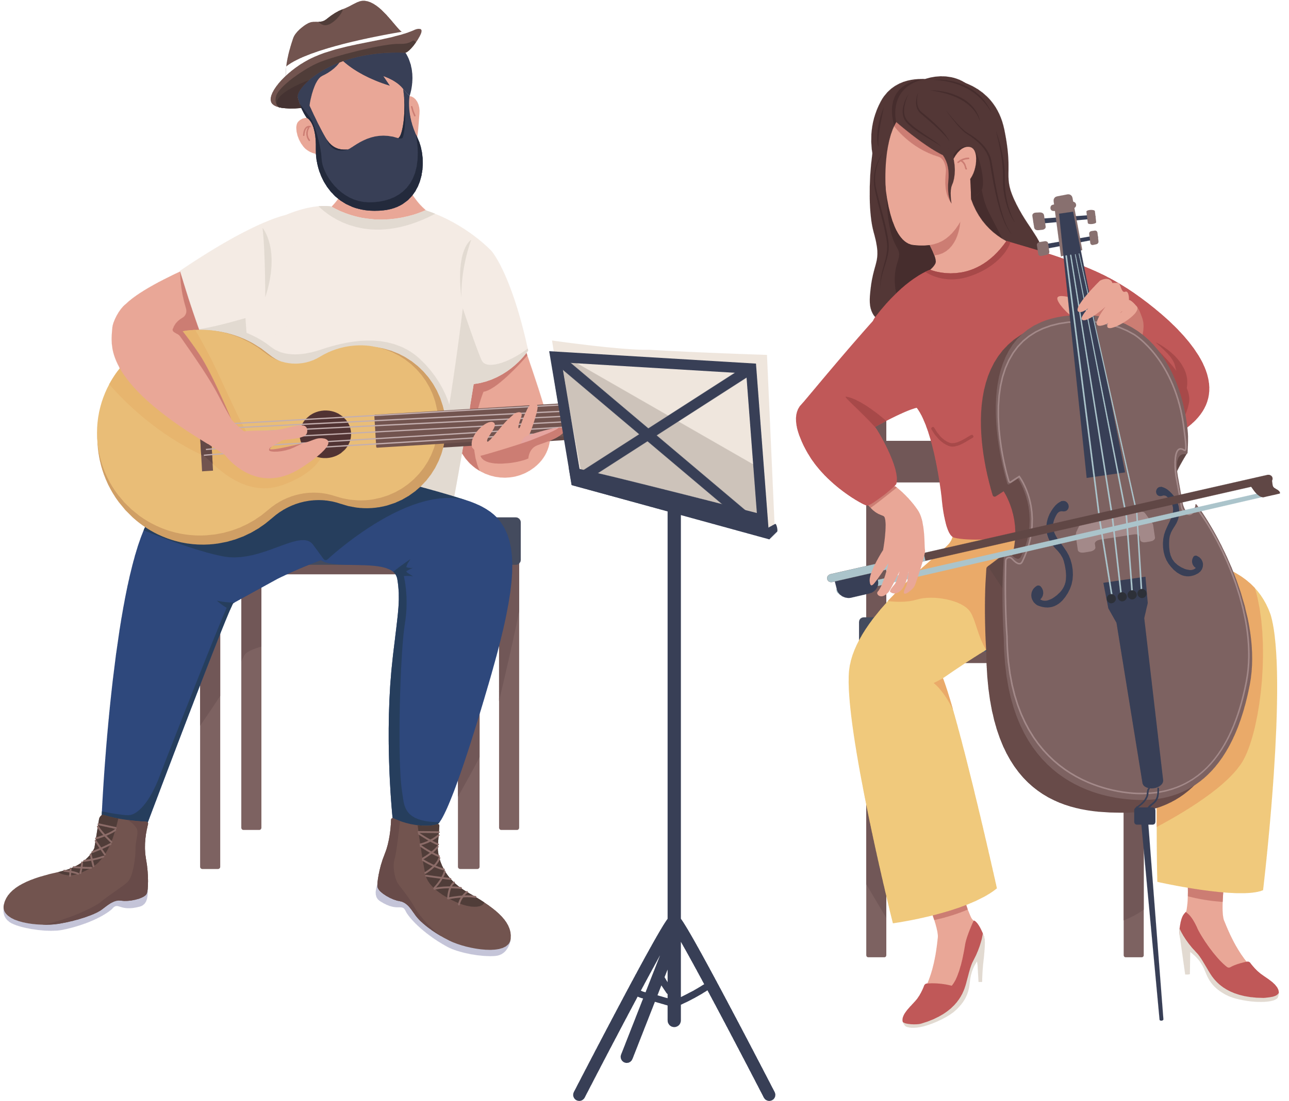





Music and Sound
Live performance
Music video
Podcast/Interviews
Produce/write a song
Live accompaniment
Audio drama

Slide 9





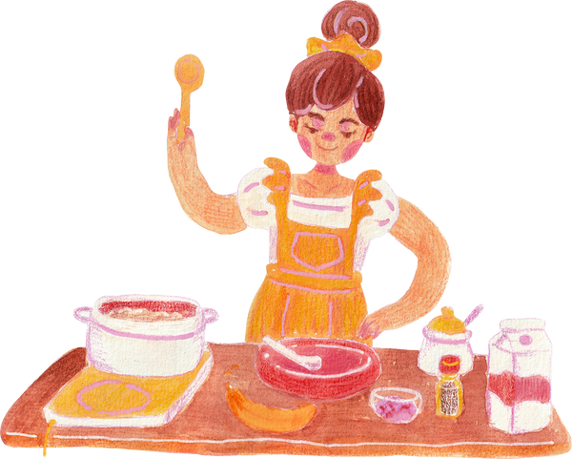
Films and Videos
Montage
Documentary
Short film
Challenges
Animation
Cooking videos

Slide 10
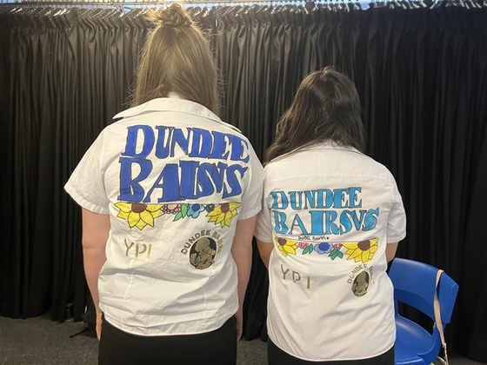
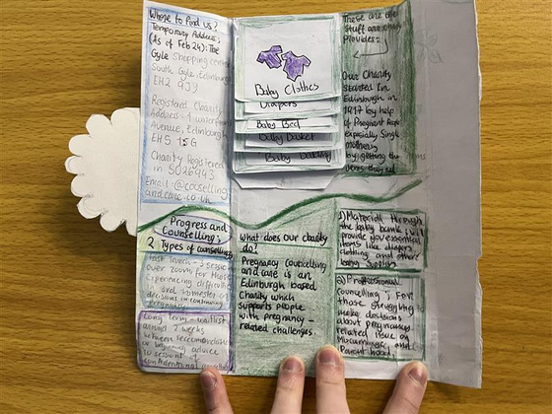

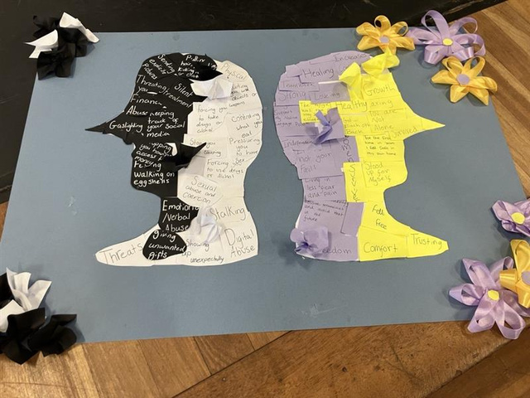

Get Arty
Make, bake, colour & create!

Slide 11

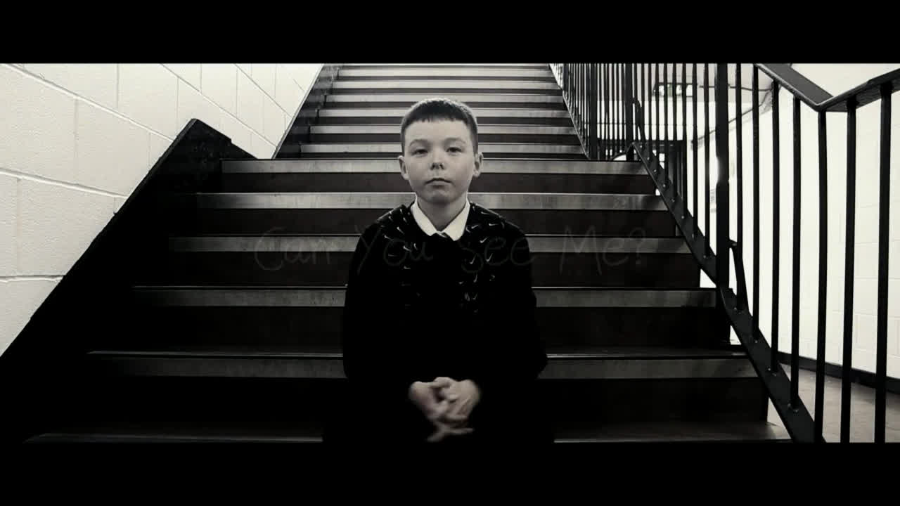
Bring the Drama

