Slide 1


© The Wood Foundation 2026/27

Slide 2

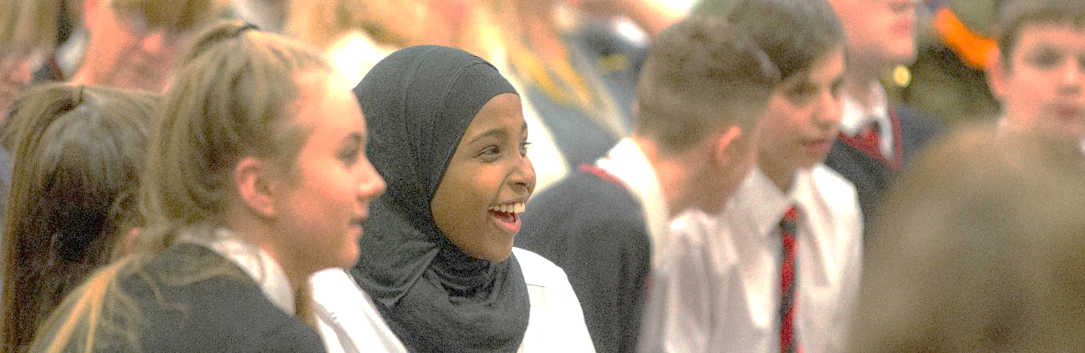
IS ABOUT
MAKING A DIFFERENCE
© The Wood Foundation 2026/27

Slide 3
Part One:
Understanding social issues and my local community
Learning Intentions:
To revisit the purpose of engaging in the YPI process.
To understand what a social issue is.
To understand the importance of teamwork for YPI.
To select a social issue as a team to focus on for YPI.
© The Wood Foundation 2026/27

Slide 4
Skills
Manage change
Work with others
Make change
Focusing
Feeling
Curiosity
Concentrating
Engaging
Sorting
Filtering
Social conscience
Empathy
Respect
Sense of responsibility
Observing
Questioning
Researching
Recognising problems
© The Wood Foundation 2026/27

Slide 5
Think, Pair, Share
What is a social issue?
Can you give a definition?
An example?
What is a social issue?
© The Wood Foundation 2026/27

Slide 6
Social Issues
When people in your community face barriers to having everything they need for a healthy and independent life financially, emotionally, physically, socially, and mentally.
© The Wood Foundation 2026/27

Slide 7
Class
Discussion
What social issues impact our community?
© The Wood Foundation 2026/27

Slide 8




Class Discussion
© The Wood Foundation 2026/27

Slide 9
Some examples of social issues: can you add 3 more?
Food poverty | Homelessness | Young carers
Bullying | Substance misuse | Mental health
© The Wood Foundation 2026/27

Slide 10
Free choice of activity
Activity 2: Put your money where your mouth is! Explain how you would spend £5000 across these 9 social issues.
Activity 1: Diamond 9
Most important
Some examples of social issues: can you add 3 more?
Food Poverty | Homelessness | Young Carers
Bullying | Substance Misuse | Mental Health
Least important
© The Wood Foundation 2026/27

Slide 11
Class
Discussion
What social issue have you researched?
What most surprised you from what you learned?
© The Wood Foundation 2026/27

Slide 12
IS ABOUT
COMMUNITY
© The Wood Foundation 2026/27

Slide 13
Part Two:
Exploring the third sector
Learning Intentions:
To better understand how the third sector and charities operate.
To reflect on how charities evaluate outcomes and impact.
To fully understand the YPI eligibility criteria and shortlist three charities.
To research the impact of shortlisted charities on the local community.
To prepare a team project timeline.
© The Wood Foundation 2026/27

Slide 14
Skills
Manage change
Work with others
Make change
Adapting
Communicating
Sense making
Positive attitude
Reflecting
Being resilient
Persevering
Listening and reading
Talking and writing
Working with technology
Giving information
Receiving information
Analysing
Understanding
Recognising opportunities
Recognising patterns
© The Wood Foundation 2026/27

Slide 15

Activity
To be eligible for the YPI grant your charity must be OSCR registered.
Search the OSCR website
Select two charities registered in your local area.
Find out what they do and who they help.
© The Wood Foundation 2026/27

Slide 16
Class
Discussion
What charities are working in our local community?
What have you found inspiring?
© The Wood Foundation 2026/27

Slide 17
Think, Pair, Share
What did your friends and family know about your shortlisted charities?
What does this tell us about charities operating locally?
Are they well known?
What is a social issue?
Charities within
the local area
© The Wood Foundation 2026/27

Slide 18
IS ABOUT
TEAMWORK
© The Wood Foundation 2026/27

Slide 19
Part Three:
Charity selection and active research
Learning Intentions:
To better understand how the third sector and charities operate.
To reflect on how charities evaluate outcomes and impact.
To fully understand the YPI eligibility criteria and shortlist three charities.
To research and further understand the impact of shortlisted charities on the local community.
To reach a consensus on which charity will be focused on for YPI and prepare a team project timeline.
© The Wood Foundation 2026/27

Slide 20
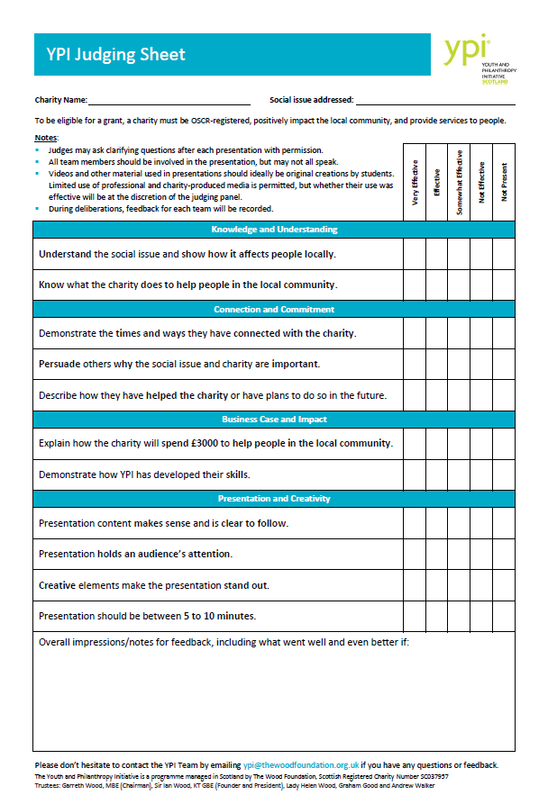
The Judging Criteria
JUDGING CRITERIA
Knowledge & Understanding
Connection & Commitment
Understand your social issue and charity.
Connect with and help your charity.
Business Case & Impact
Presentation & Creativity
Presentation is engaging, easy to follow and creative.
How £3000 could help locally and what skills you have developed through YPI.
© The Wood Foundation 2026/27

Slide 21
Skills
Manage change
Work with others
Make change
Initiative
Collaborating
Critical thinking
Building relationships Teamwork
Compromising
Cooperating
Logical thinking
Using judgement
Evaluating
Problem solving
Being resourceful
Self-motivation
Taking responsibility
Decision making
© The Wood Foundation 2026/27

Slide 22
Step 1
Making contact with your charity
Gather the contact details for your charity
  Contact name and job title
  Phone number
  Email address
  Social media account (if the above is not available)
© The Wood Foundation 2026/27

Slide 23
Step 2
Making contact with your charity
Before phoning your charity, you should prepare a script that:
Tells the charity your first name, what year you are in and the school you attend.
Explains what YPI is, why you have chosen their charity and how they will benefit from the programme.
Asks the charity if they want to be represented and when would be a good time to arrange a visit or call to interview them.
© The Wood Foundation 2026/27

Slide 24
Step 3
Making contact with your charity
Before calling:
  Practice your script.
  Make sure you have a pen and something to write on.
If they answer: Use your script. Be polite and interested. Write down what you agree.
If they don’t answer: Leave a very clear voicemail and try again in the future.
© The Wood Foundation 2026/27

Slide 25
Class
Discussion
What information do you need to find out during your charity interview and/or visit?
© The Wood Foundation 2026/27

Slide 26
Activity
How do you feel?
Reflect on the upcoming charity contact and presentations.
On post-it notes, write down:
One thing you are excited about.
One thing you are nervous or apprehensive about.
© The Wood Foundation 2026/27

Slide 27
ENCOURAGES YOU TO BE UNIQUE, ENGAGING, THOUGHT-PROVOKING, AND MEMORABLE
© The Wood Foundation 2026/27

Slide 28
Part Four:
Presentation development
Learning Intentions
To deliver a presentation that demonstrates a clear understanding of the chosen social issue and respective charity, including information relating to impact and outcomes.
To develop and deliver an engaging and creative presentation that fulfils the judging criteria.
To ensure all team members are actively involved in the presentation development process.
© The Wood Foundation 2026/27

Slide 29
Skills
Manage change
Work with others
Make change
Initiative
Collaborating
Creativity
Building relationships Teamwork
Compromising
Cooperating
Imagination
Generating ideas
Designing and innovating
Being resourceful
Being resourceful
Self-motivation
Taking responsibility
Decision making
© The Wood Foundation 2026/27

Slide 30
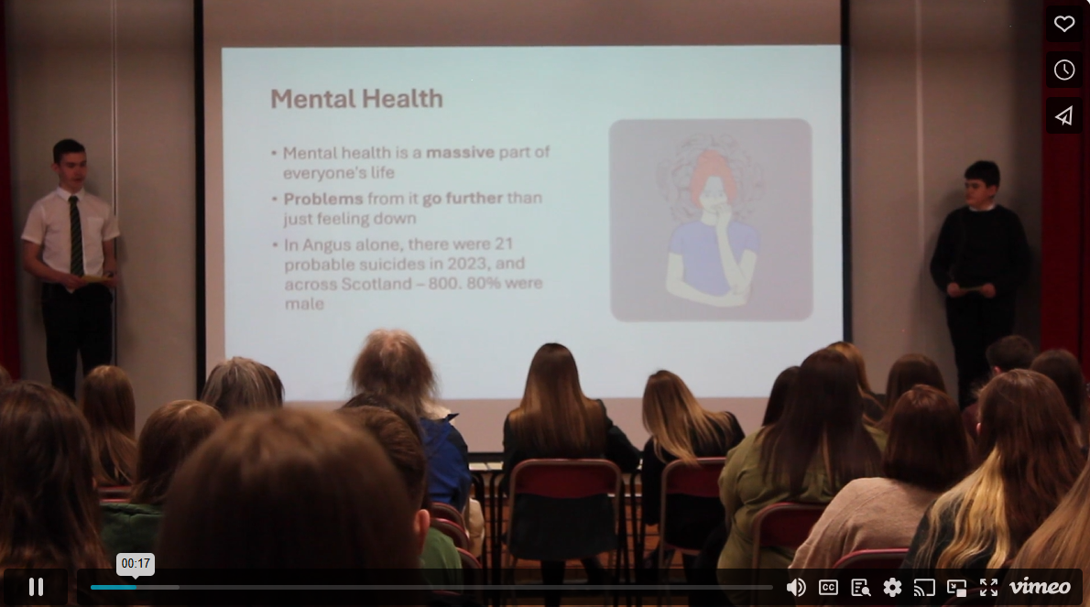
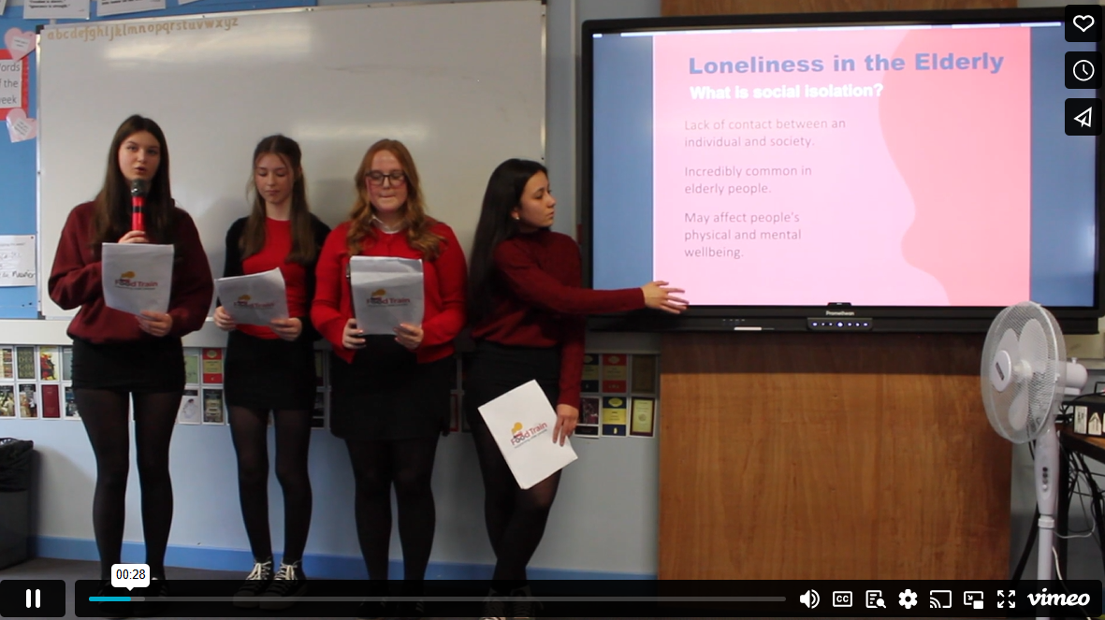

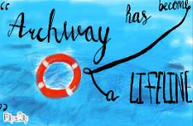
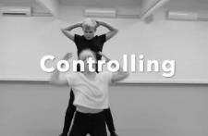
Class
Discussion
Consider the content, delivery and engagement of these presentations.
Look at the following examples of creativity. What makes them stand out?
© The Wood Foundation 2026/27

Slide 31
Team Discussion
How can you use your talents to make an impactful and memorable presentation?
© The Wood Foundation 2026/27

Slide 32
WHAT NEXT?
© The Wood Foundation 2026/27

Slide 33
Class
Discussion
What did you learn about your values through YPI?
What skills have you developed?
What did you learn about social issues?
Will you continue to help the charity you chose?
What was your greatest learning from your experience with YPI?
© The Wood Foundation 2026/27

