Slide 1


YPI Scotland National Partner
Operational Manager and Principal Funder of YPI in Scotland
© The Wood Foundation 2026/27

Slide 2

PHILANTHROPY
© The Wood Foundation 2026/27

Slide 3


© The Wood Foundation 2026/27

Slide 4
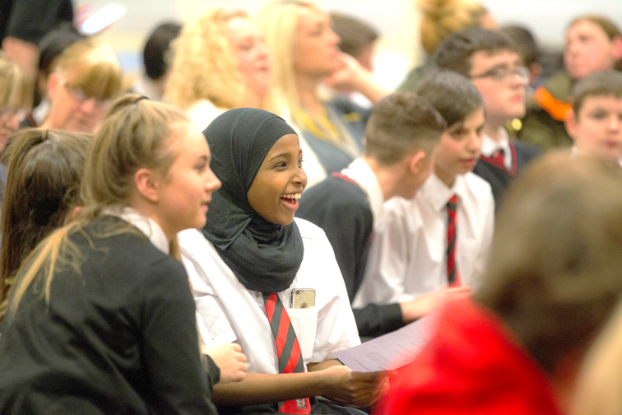
PERSONALISE YOUR LAUNCH
To personalise the Launch, you can replace one of these pictures with an image of last years winning team.
To do this, right click on the picture and select ‘Change Picture’.
© The Wood Foundation 2026/27

Slide 5

YPI Final
YPI Launch
Share Learning
Social Issues
Charities
Form Teams
Research
© The Wood Foundation 2026/27

Slide 6


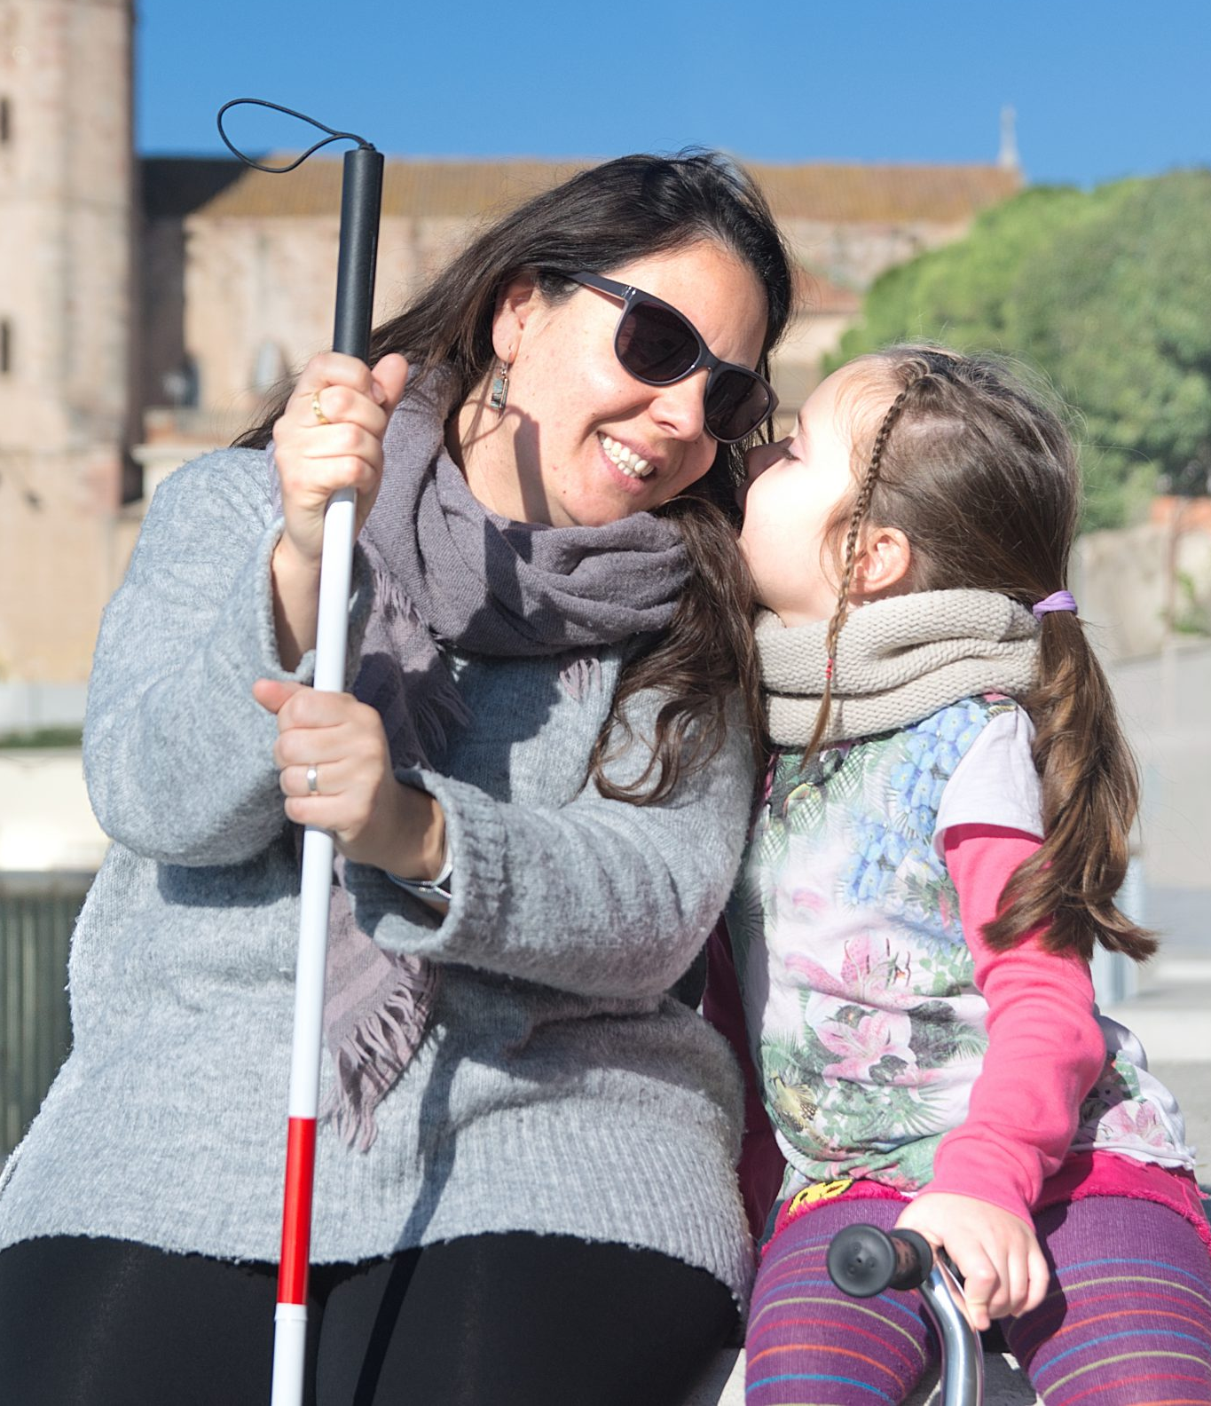
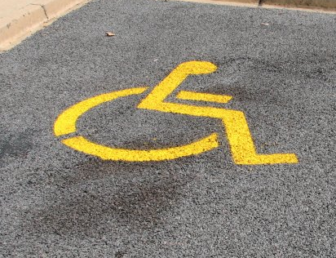


© The Wood Foundation 2026/27

Slide 7
YPI Final
YPI Launch
Share Learning
Social Issues
Charities
Form Teams
Research
© The Wood Foundation 2026/27

Slide 8
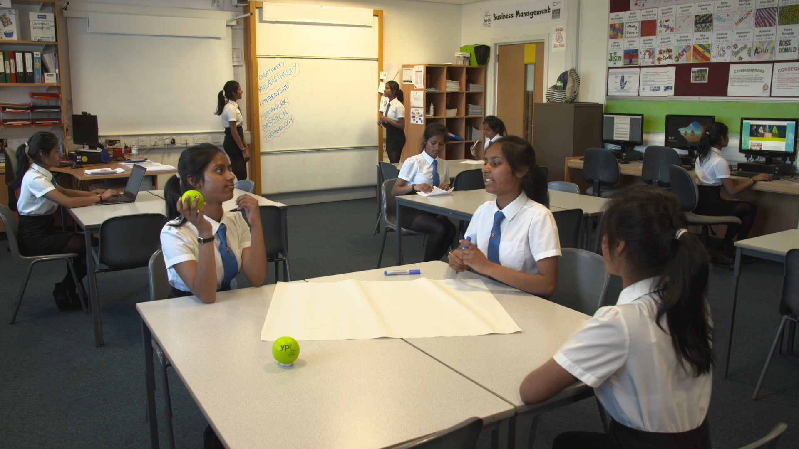
© The Wood Foundation 2026/27

Slide 9
YPI Final
YPI Launch
Share Learning
Social Issues
Charities
Form Teams
Research
© The Wood Foundation 2026/27

Slide 10

904*
Registered charities in Aberdeen
660*
Registered charities in
Dundee
2,892*
Registered charities in
Glasgow
497*
Registered charities in
Moray
928*
Registered charities in
Perth & Kinross
385*
Registered charities in
South Ayrshire
1,830*
Registered charities in Highlands
410*
Registered charities in
North Ayrshire
495*
Registered charities in
Renfrewshire
753*
Registered charities in
South Lanarkshire
1,298*
Registered charities in Aberdeenshire
347*
Registered charities in
East Ayrshire
518*
Registered charities in
Angus
257*
Registered charities in
East Dunbartonshire
PERSONALISE YOUR LAUNCH
24,992*
Registered charities in Scotland
Social
Community Focused
821*
Registered charities in
Argyll & Bute
464*
Registered charities in
East Lothian
To personalise the Launch, you can add the number of registered charities in your council area.
To do this, zoom out to find your council area and then just drag and drop the text box into the shaded green box.
2,928*
Registered charities in Edinburgh
256*
Registered charities in
East Renfrewshire
Local
Impact
OSCR Registered
*August 2026
WWW.OSCR.ORG.UK
© The Wood Foundation 2026/27
175*
Registered charities in Clackmannanshire
374*
Registered charities in
Falkirk
621*
Registered charities in
North Lanarkshire
801*
Registered charities in
Scottish Borders
520*
Registered charities in
Stirling
502*
Registered charities in
West Lothian
205*
Registered charities in
Inverclyde
400*
Registered charities in
Midlothian
247*
Registered charities in
Orkney Islands
279*
Registered charities in
Shetland Islands
207*
Registered charities in
West Dunbartonshire
344*
Registered charities in
Western Isles
858*
Registered charities in Dumfries & Galloway
1,351*
Registered charities in
Fife

Slide 11
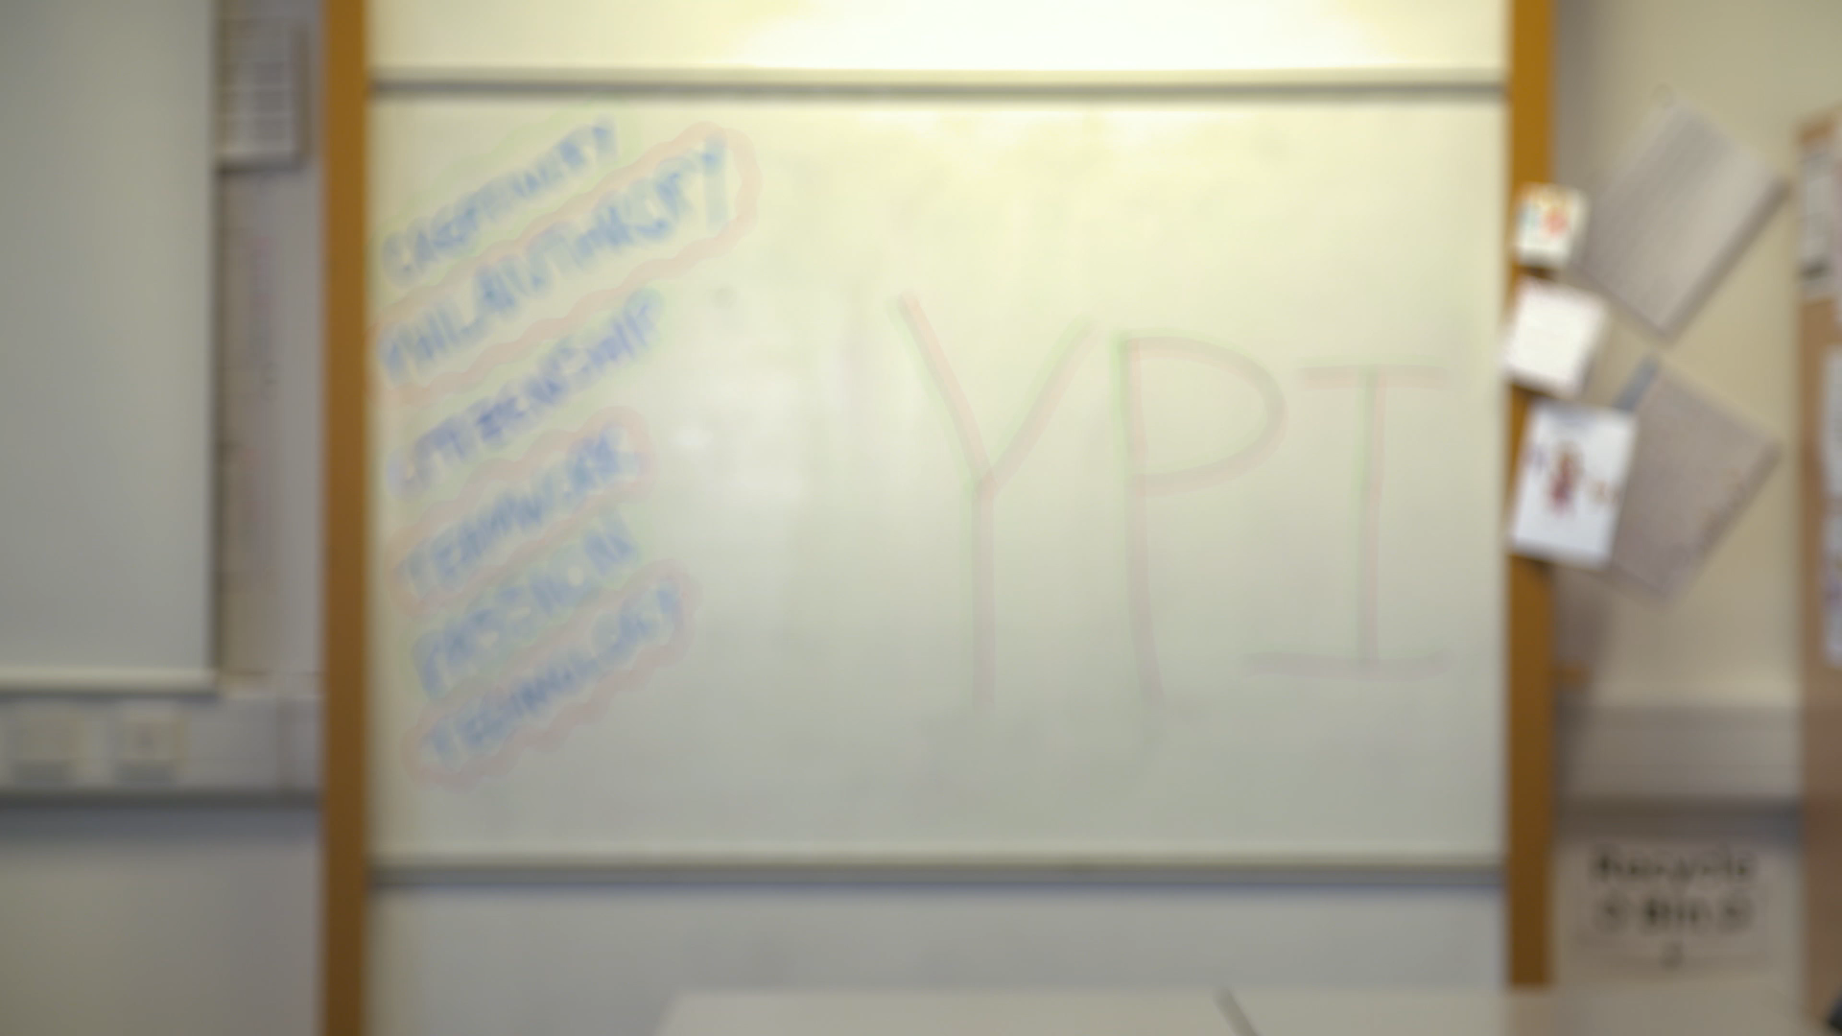
© The Wood Foundation 2026/27

Slide 12
YPI Final
YPI Launch
Share Learning
Social Issues
Charities
Form Teams
Research
© The Wood Foundation 2026/27

Slide 13
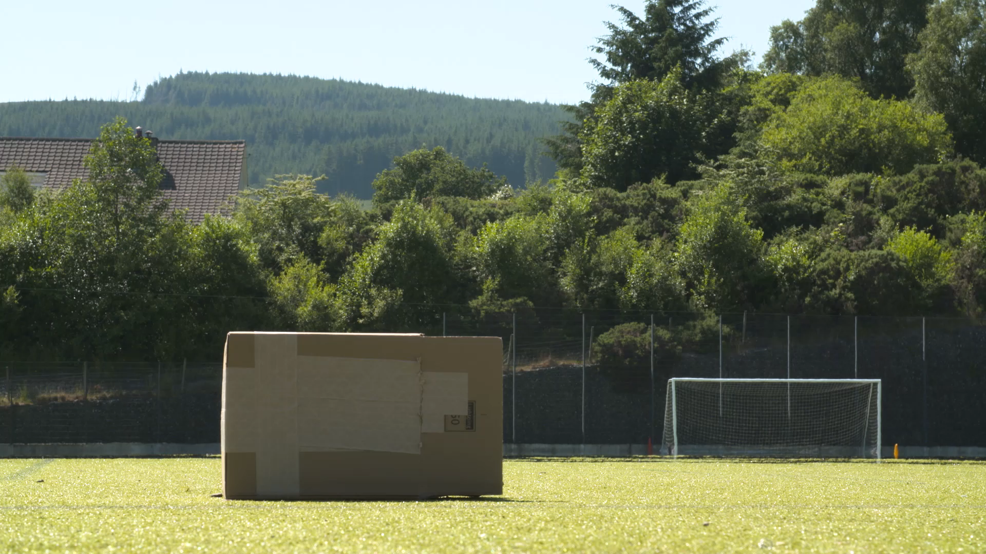
© The Wood Foundation 2026/27

Slide 14
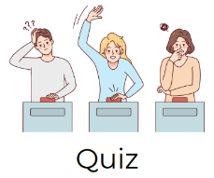



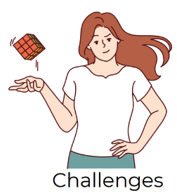



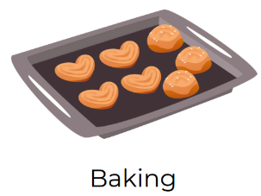
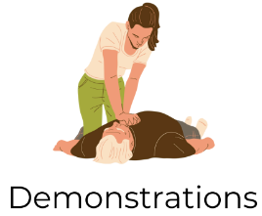







Arts and Crafts
Spoken Word
Activities
Quiz
Drama
Short film
Leaflets
Challenges
Digital
Posters
Live interviews
Music Video
Animations / Graphics
Music & Sound
Films & Videos
Baking
Demonstrations
Show & Tell
Story Telling
Acting
Movement
Write a song
Dance
Example kit
Website design
© The Wood Foundation 2026/27

Slide 15
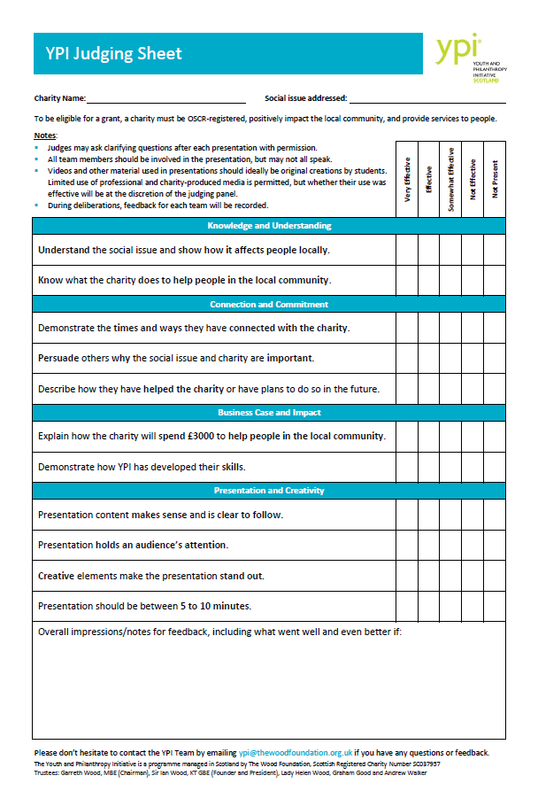
JUDGING CRITERIA
Knowledge & Understanding
Connection & Commitment
Understand your social issue and charity.
Connect with and help your charity.
Business Case & Impact
Presentation & Creativity
Presentation is engaging, easy to follow and creative.
How £3000 could help locally and what skills you have developed through YPI.
© The Wood Foundation 2026/27

Slide 16
YPI Final
YPI Launch
Share Learning
Social Issues
Charities
Form Teams
Research
© The Wood Foundation 2026/27

Slide 17
#DRIVINGCHANGE
TIME
TALENT
MONEY
© The Wood Foundation 2026/27

Slide 18

#DRIVINGCHANGE
The winning team is invited to attend the National Event in Perth (or other selected students from your school)
© The Wood Foundation 2026/27
Notes:
Where possible: all winning teams are invited to attend the National Event – You may wish to show either of this videos as a positive and inspiring way to finish the launch.
National Event 2025 video (2.5 min) https://vimeo.com/1108131869
National Event 2024 video (2.5 min) https://vimeo.com/995397693?fl=pl&fe=sh

Slide 19





Good Luck!
ypiscotland.org.uk
ypiscotland
YPI Strategic Partner
ypi_scotland
Thanks to our funding partners:
© The Wood Foundation 2026/27
Notes:
If your school won’t be able to attend the National Event in June 2026, you could finish the launch by watching the following video:
Make a Difference Video: https://vimeo.com/207319665

